Slide 1
AI in Cloud Native
Seven Cheng

Slide 2
Outline
LLM Management:
Run LLM Agent On Your Own Laptop
Run LLM on Kubernetes
GPU Management:
Manage GPU on Kubernetes
GPU Sharing & Scheduling
Failure Recovery and Fault-Tolerance

Slide 3
Run LLM Agent On Your Own Laptop

Slide 4
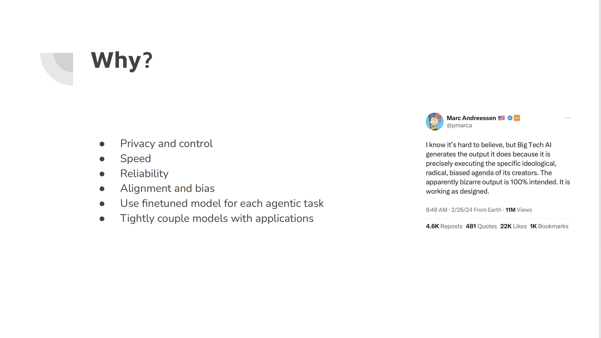

Slide 5
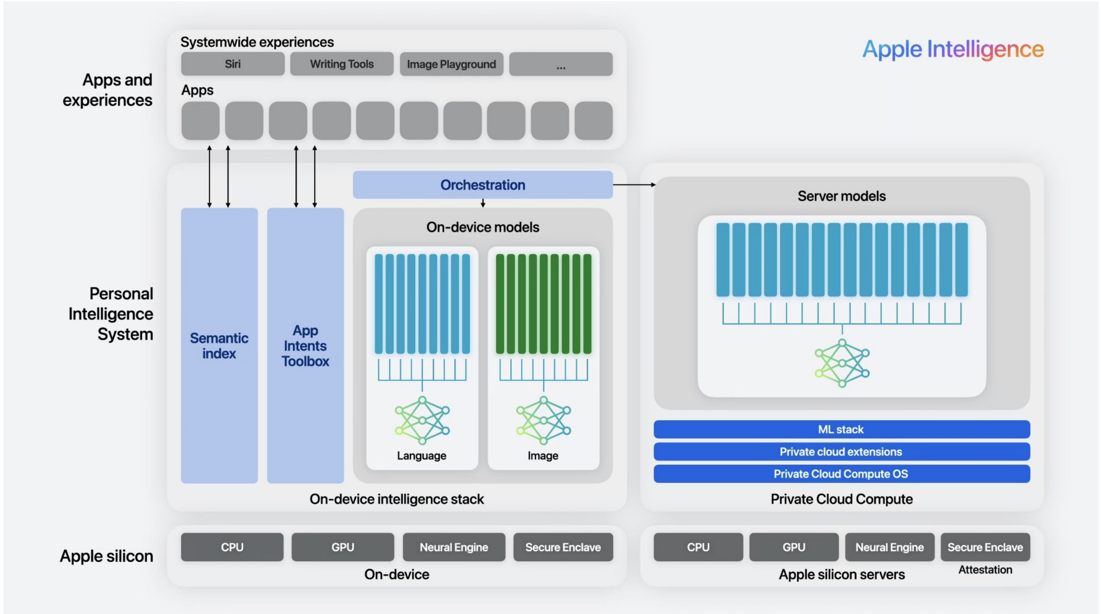

Slide 6
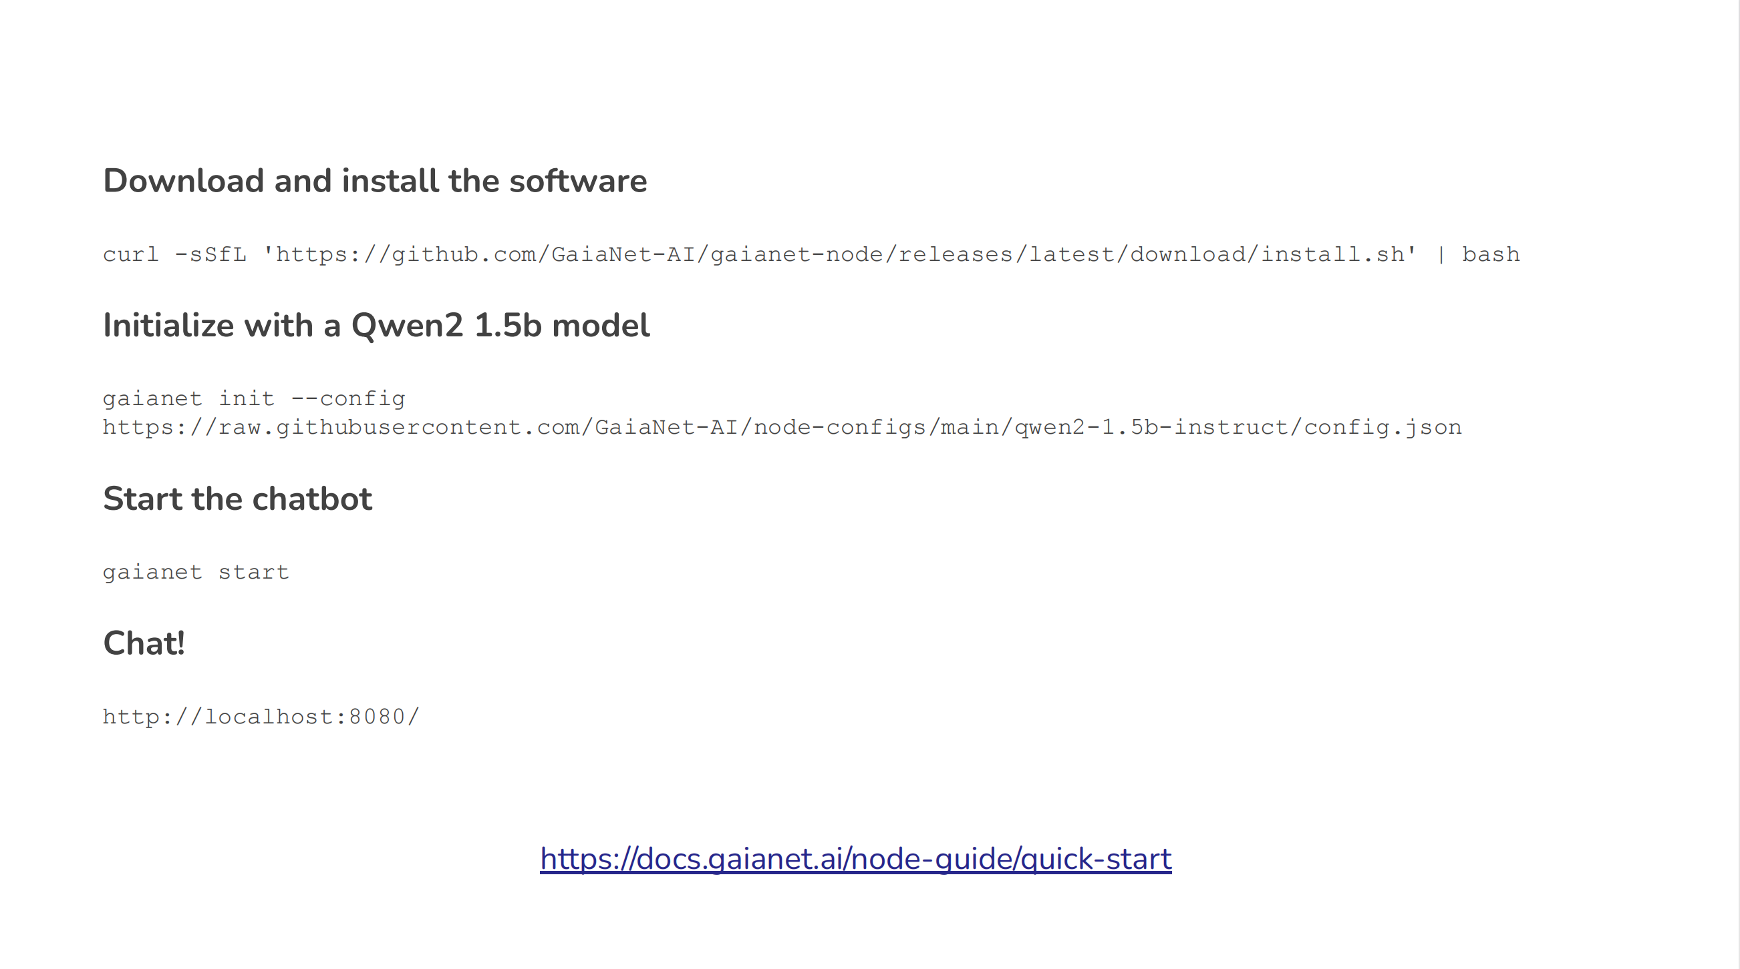
docker run --name gaianet \
-p 8080:8080 \
-v $(pwd)/qdrant_storage:/root/gaianet/qdrant/storage:z \
gaianet/phi-3-mini-instruct-4k_paris:latest

Slide 7
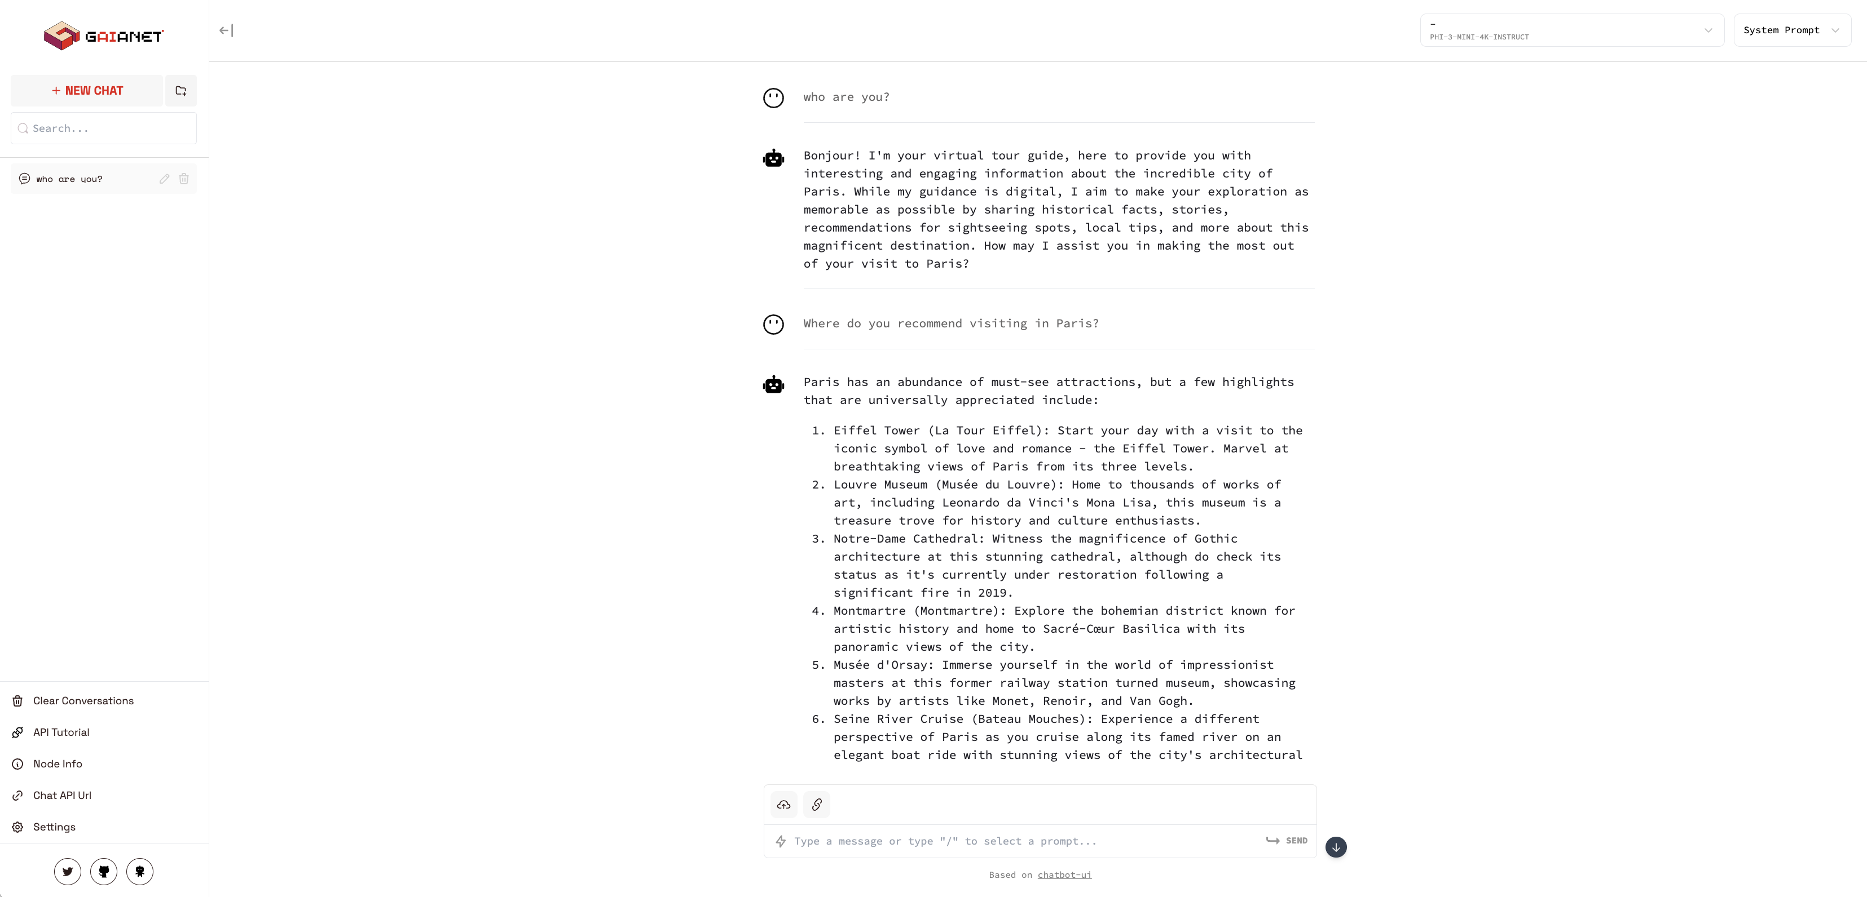
Ask Question

Slide 8
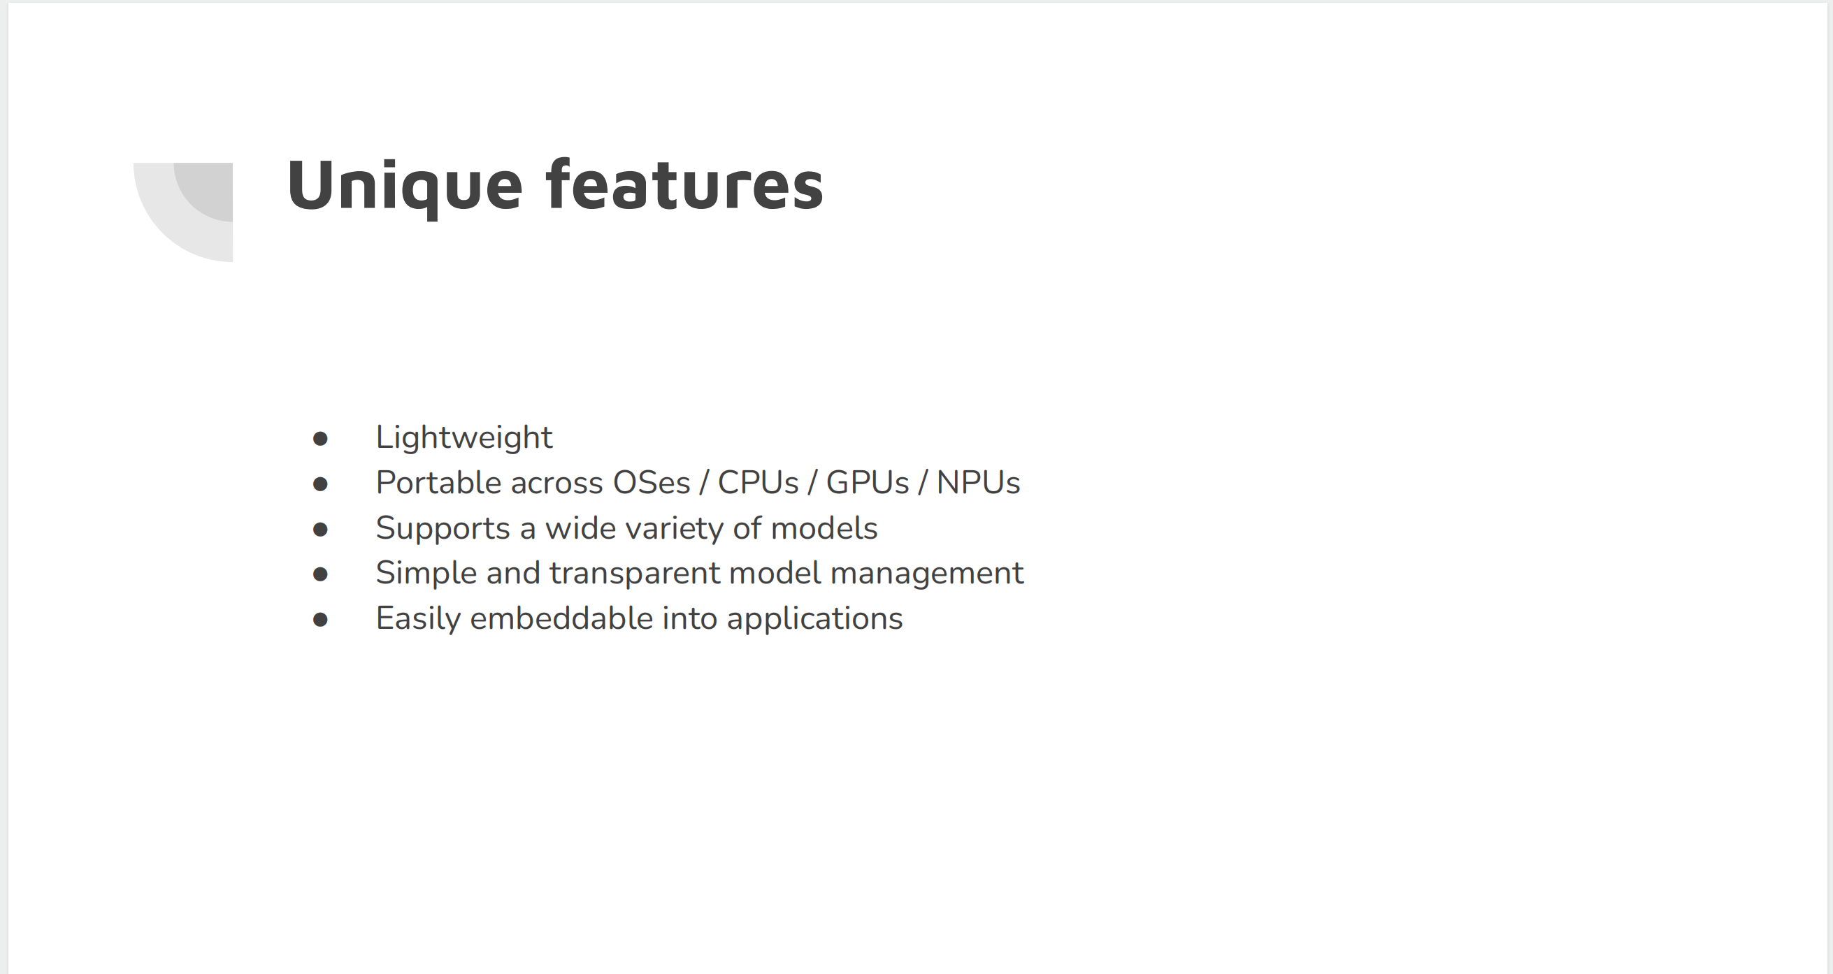
WasmEdge: https://github.com/WasmEdge/WasmEdge
LlamaEdge: https://github.com/LlamaEdge/LlamaEdge
https://docs.gaianet.ai/category/agent-frameworks-and-apps

Slide 9
Run LLM on Kubernetes

Slide 10
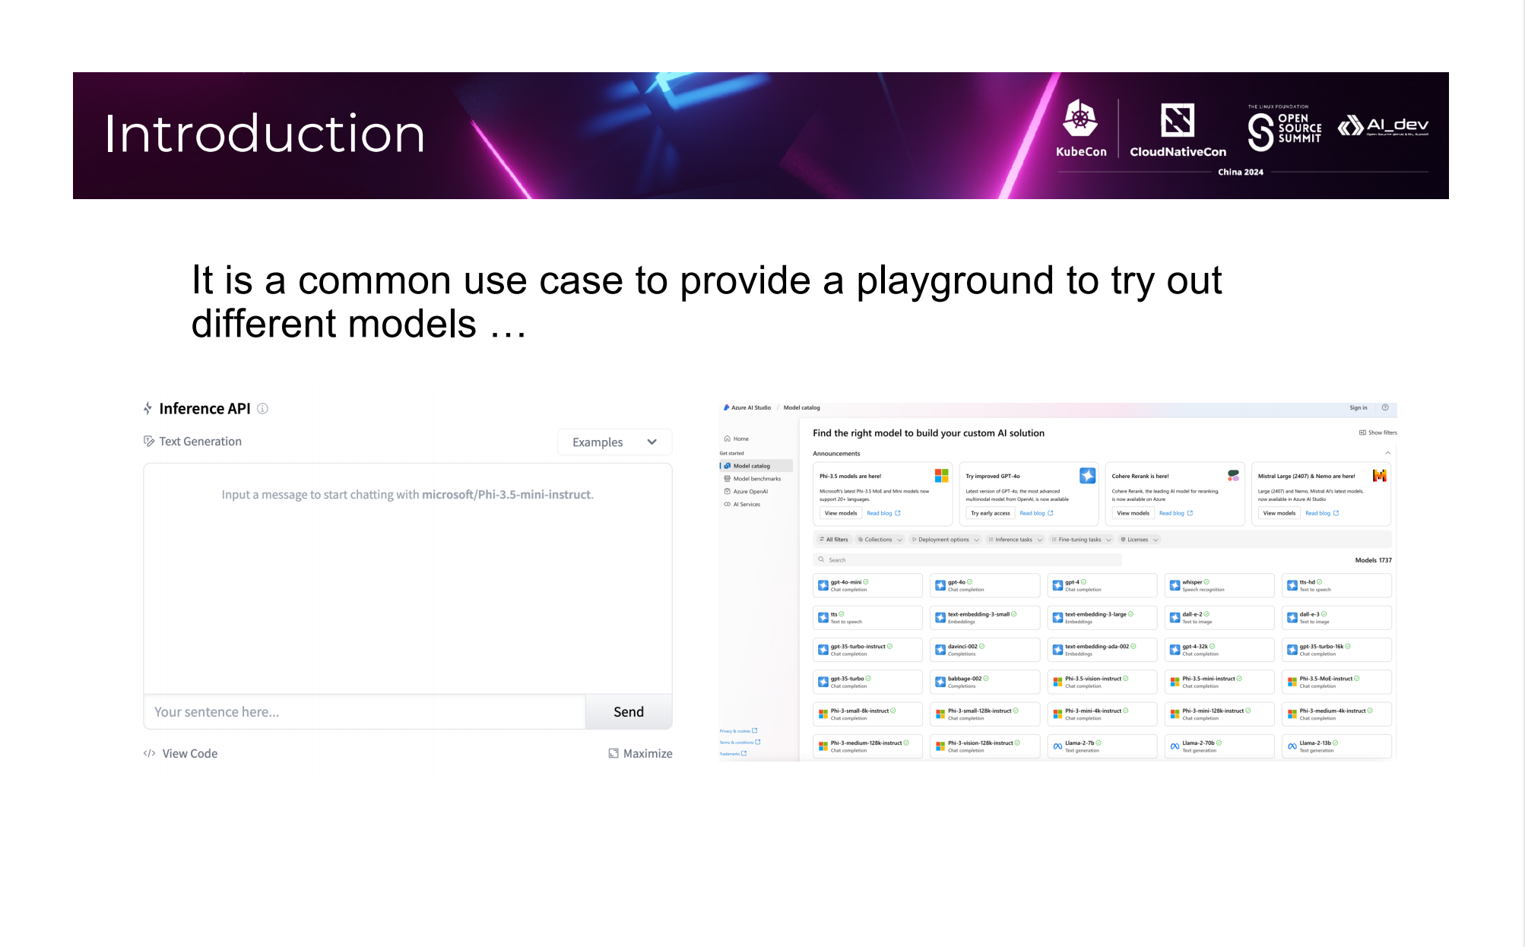

Slide 11
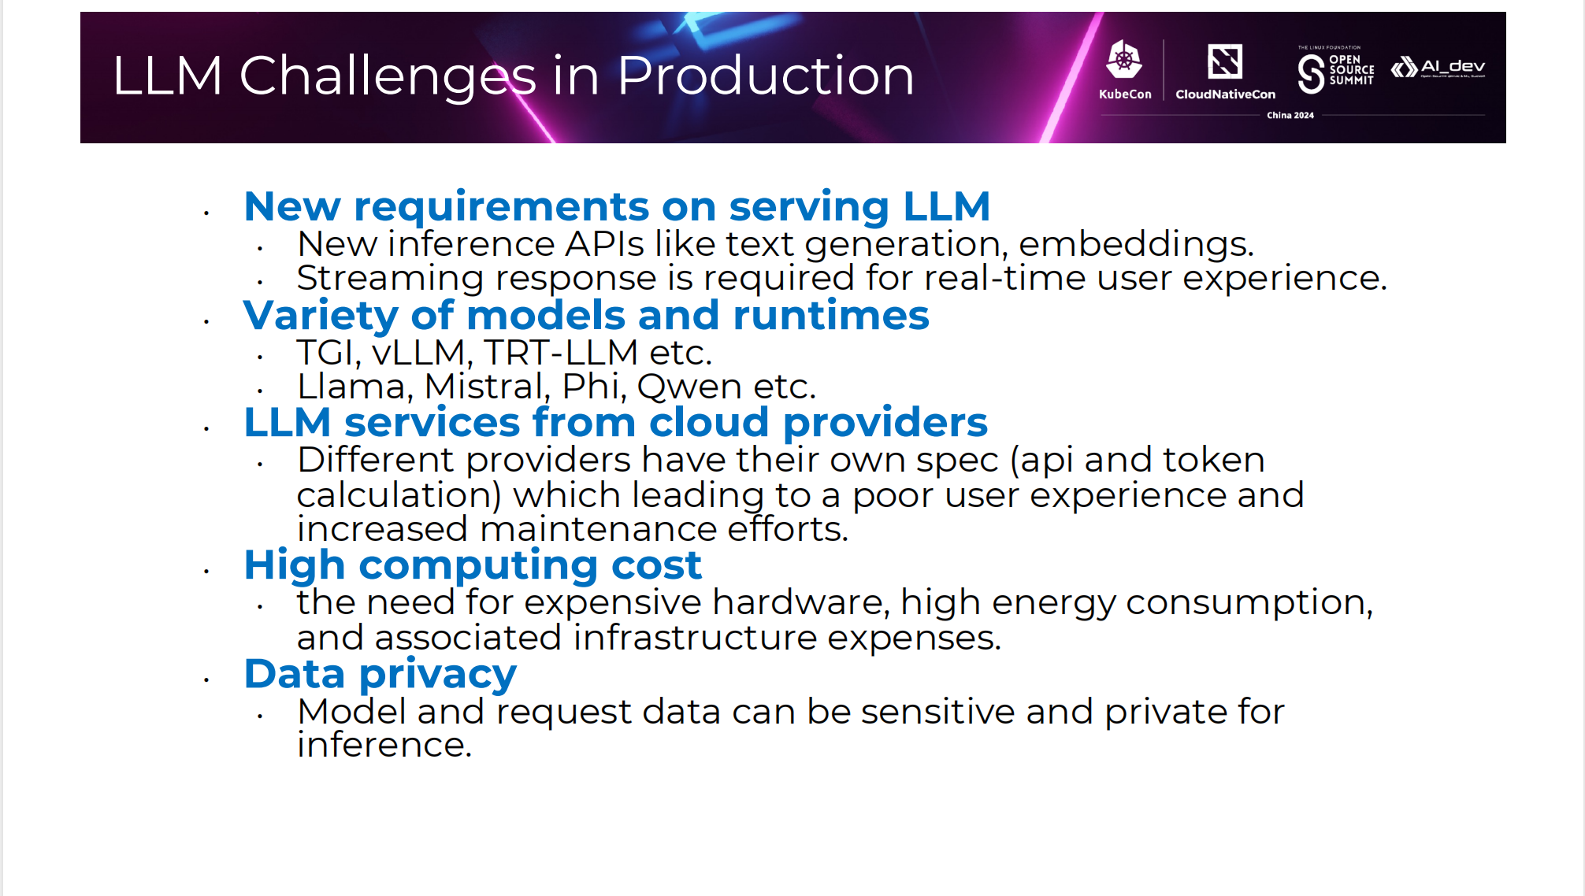

Slide 12
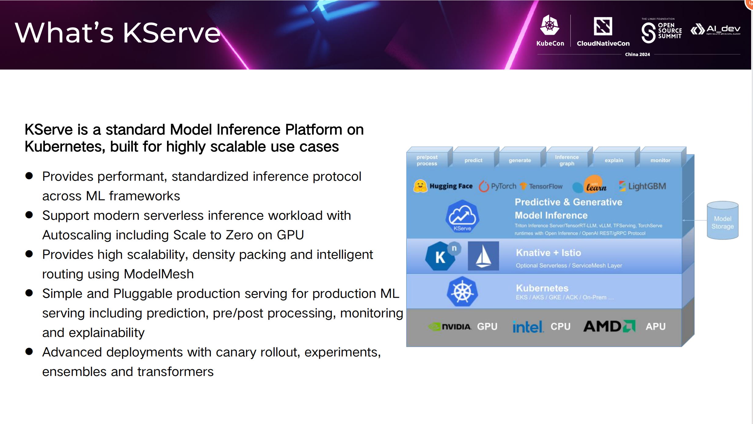

Slide 13
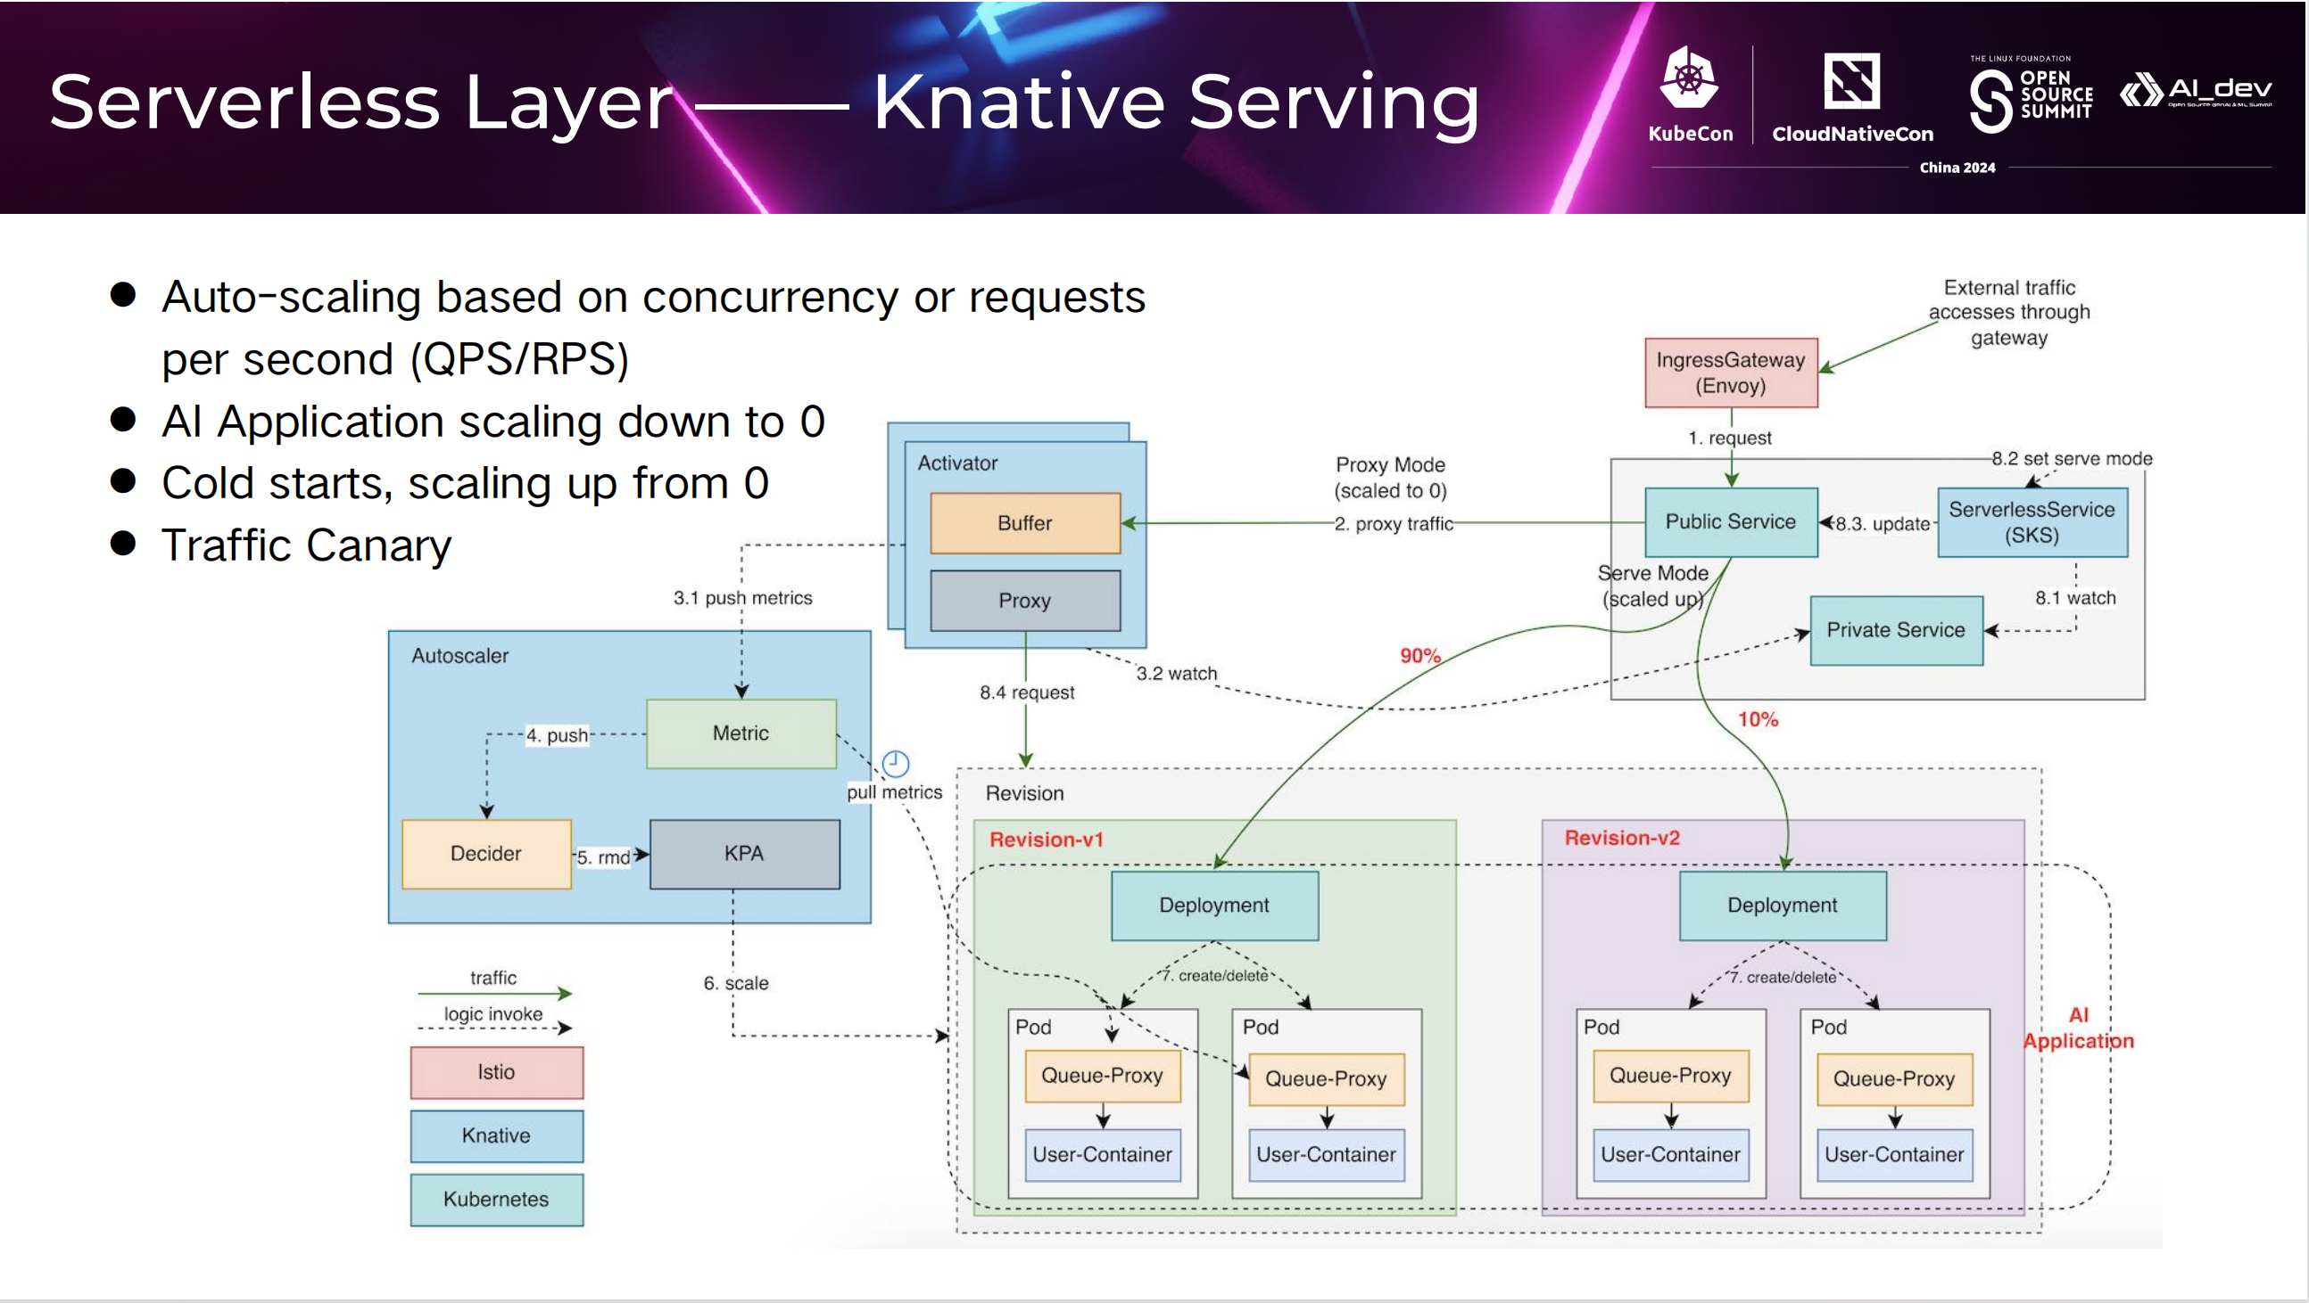

Slide 14
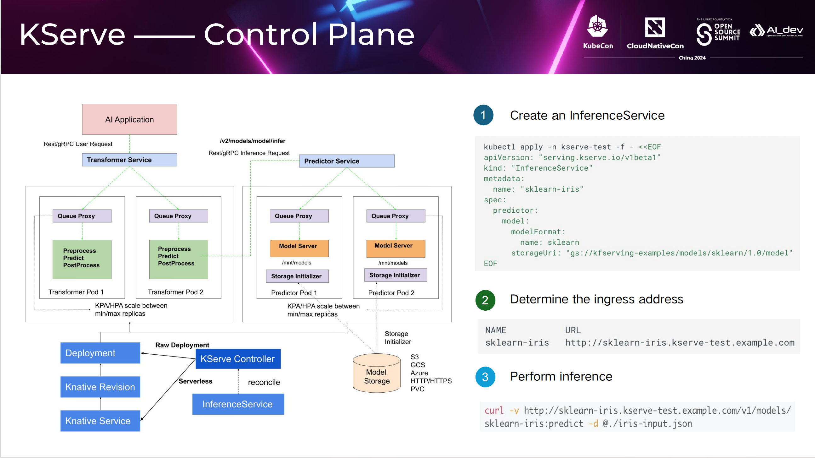

Slide 15
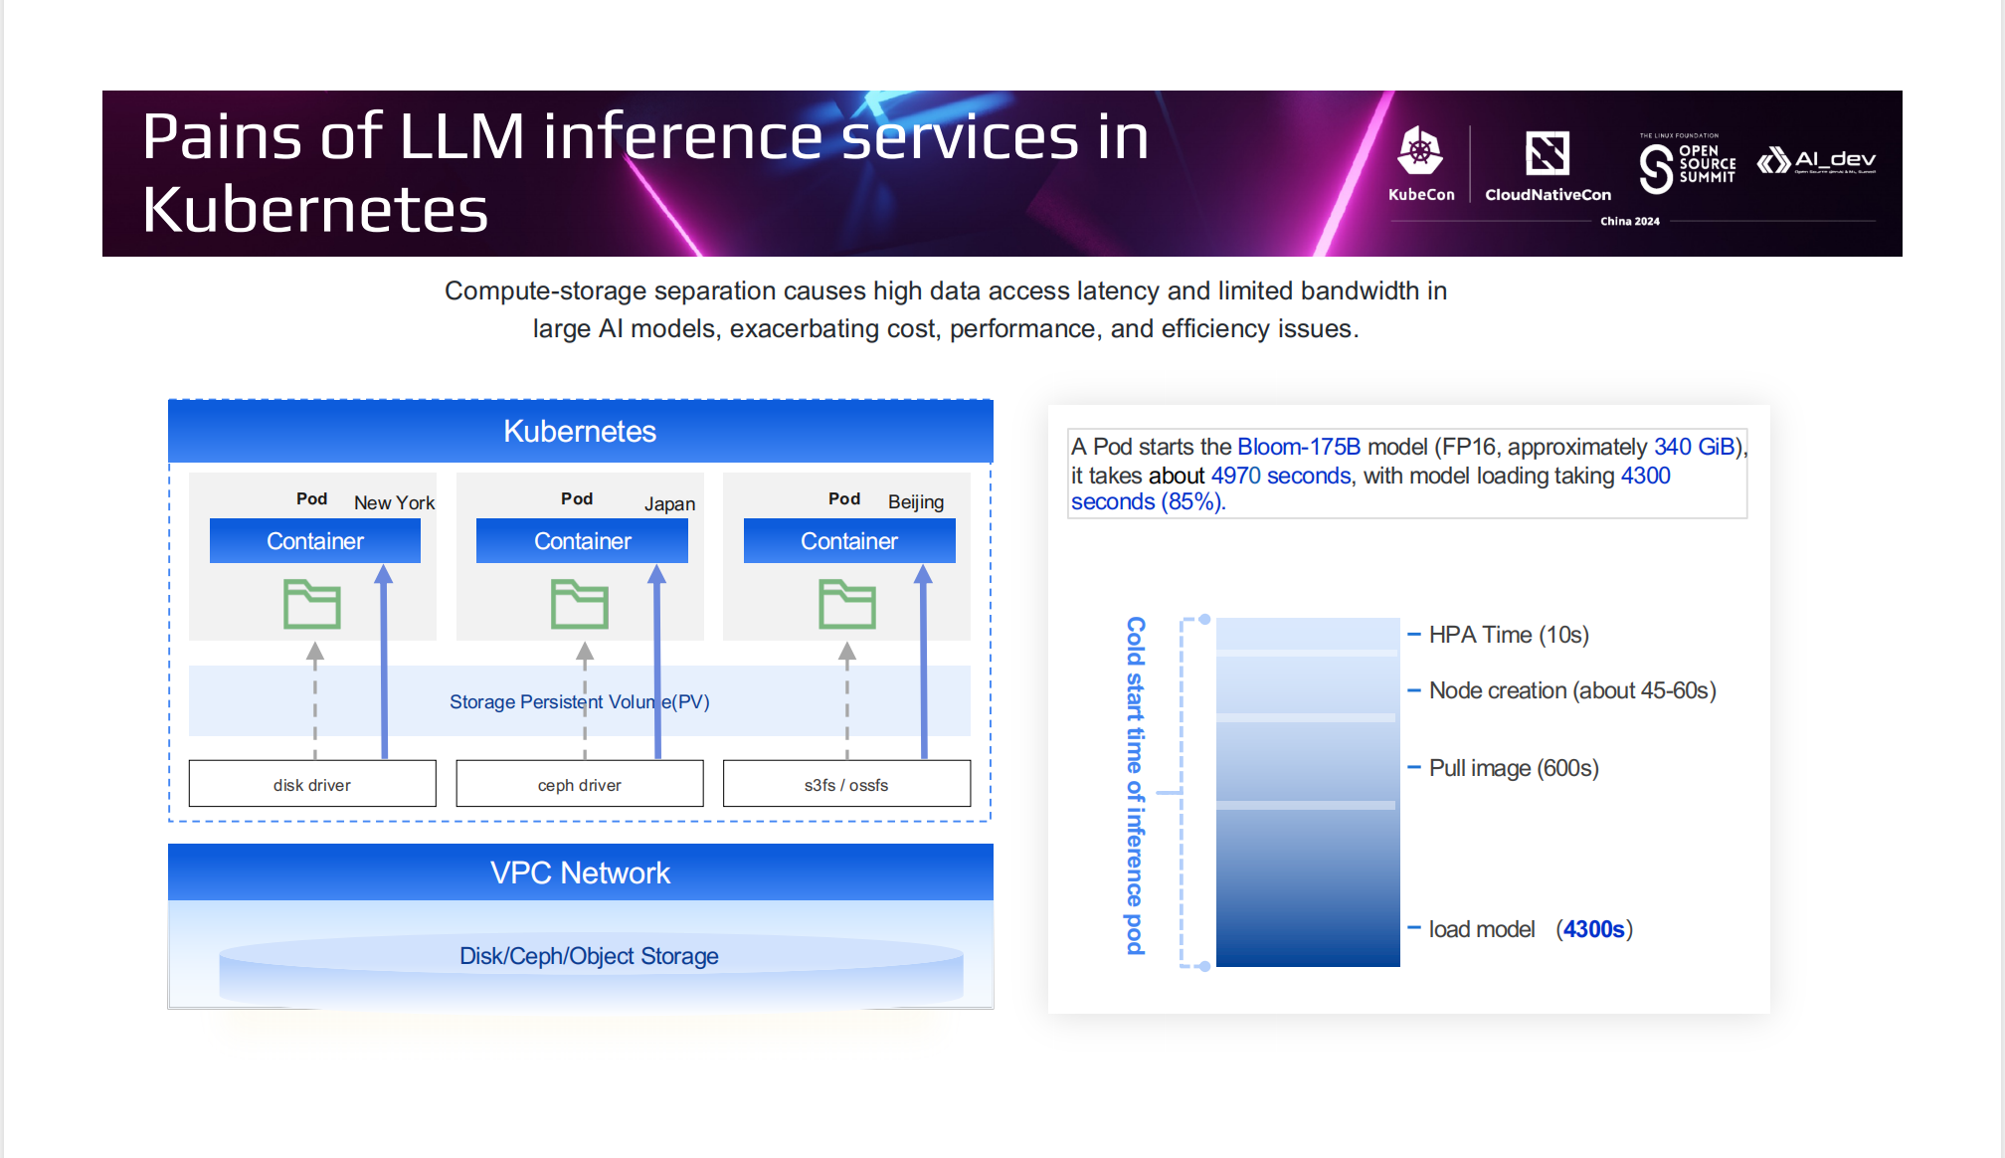

Slide 16
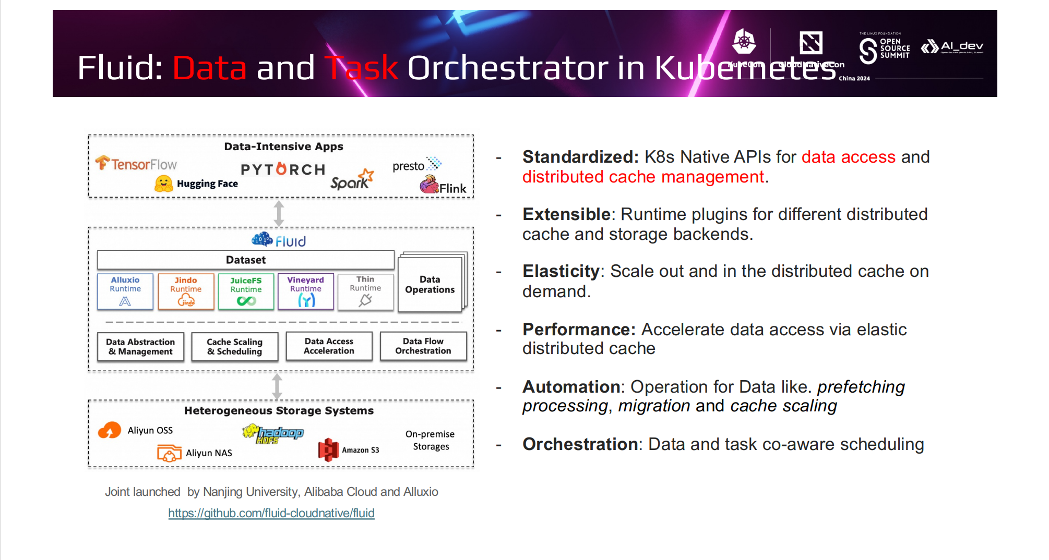

Slide 17
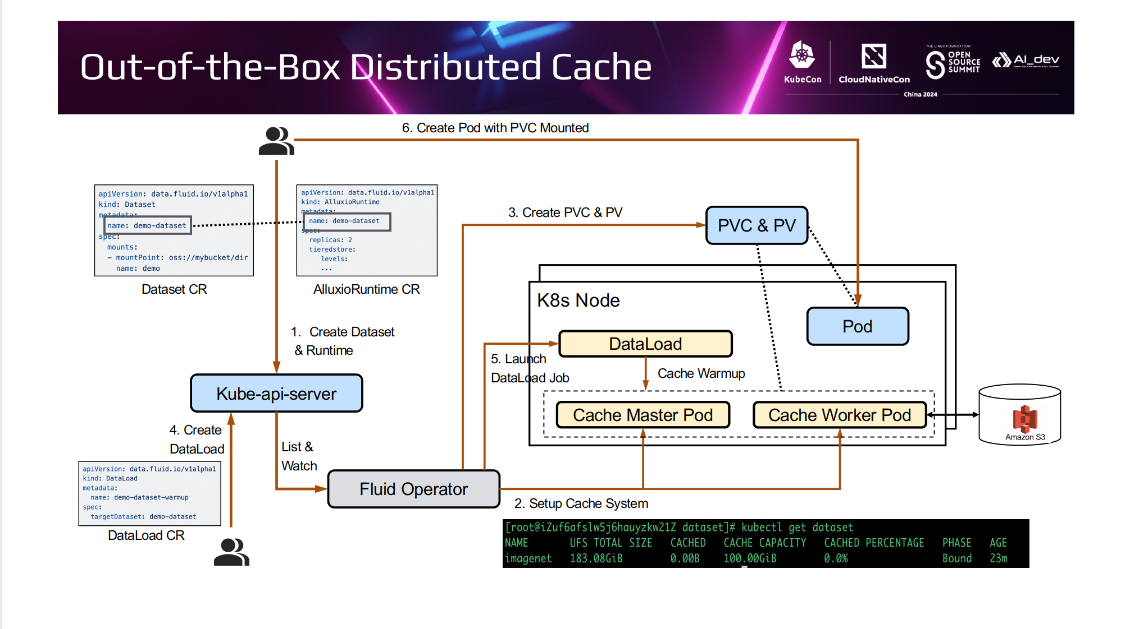

Slide 18
Manage GPU on Kubernetes

Slide 19
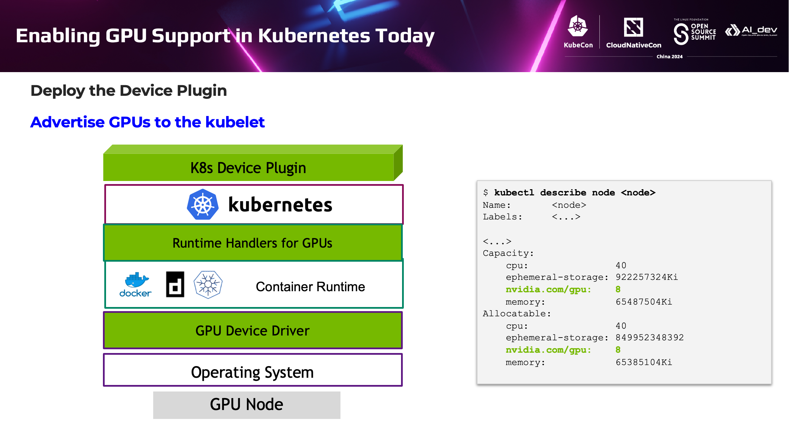

Slide 20
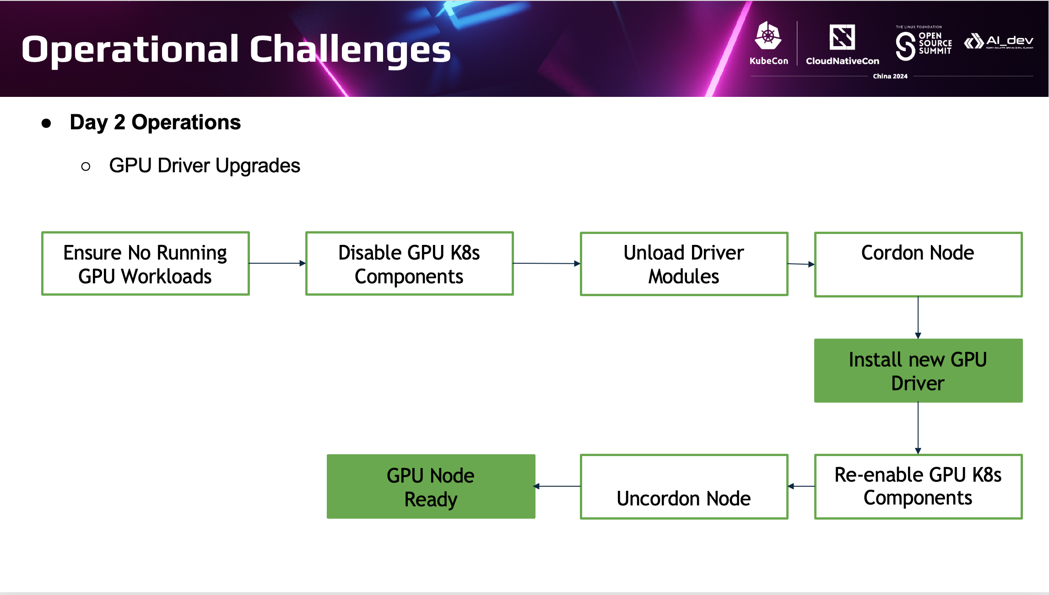

Slide 21
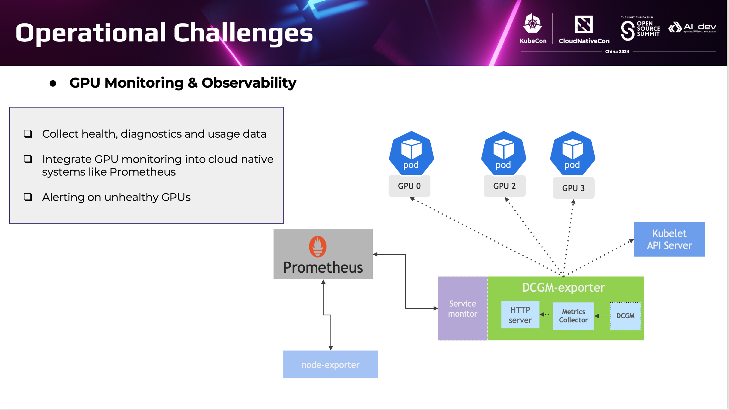

Slide 22
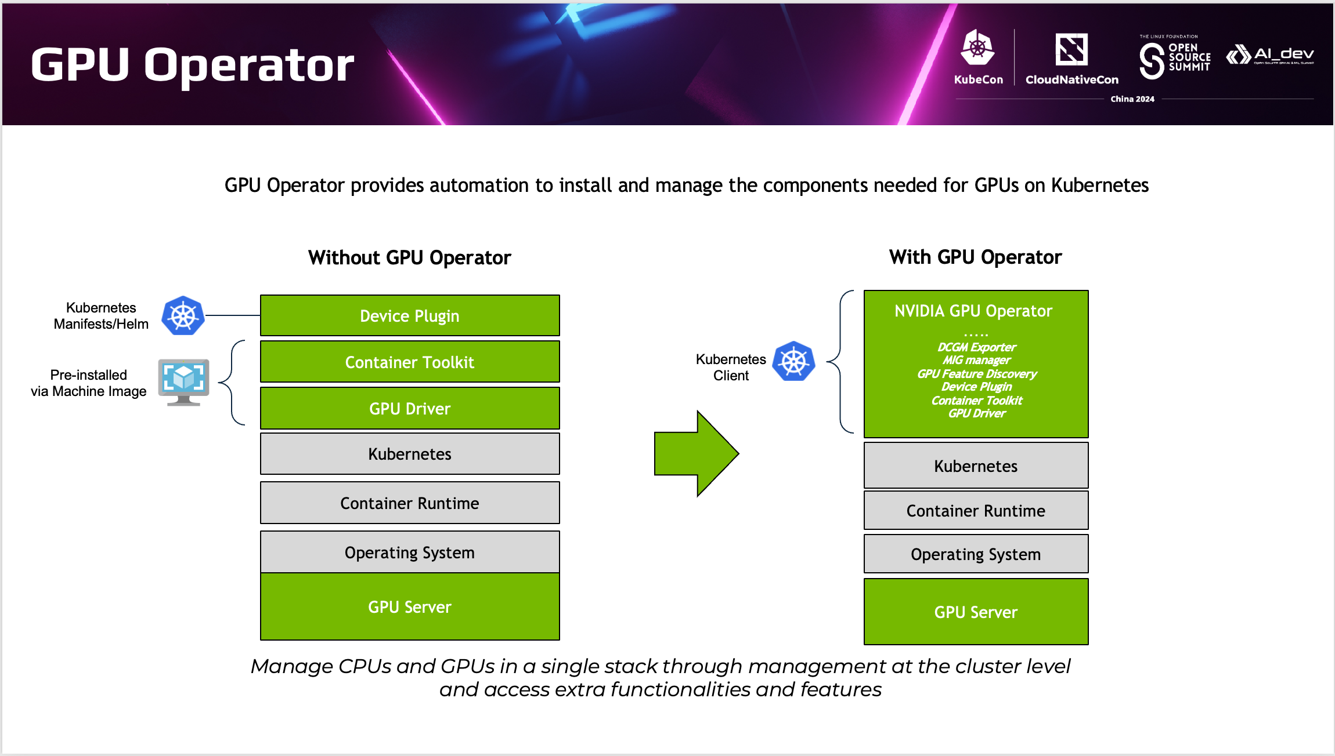

Slide 23
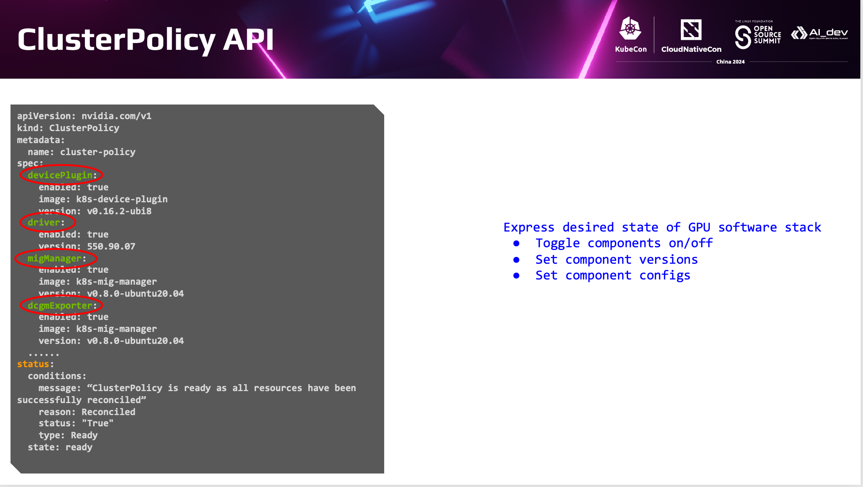

Slide 24
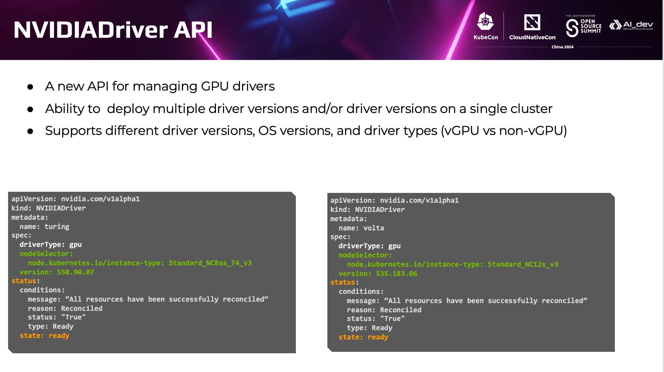

Slide 25
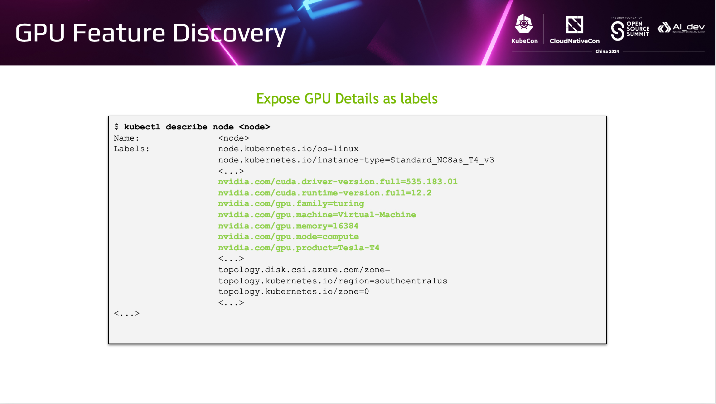

Slide 26
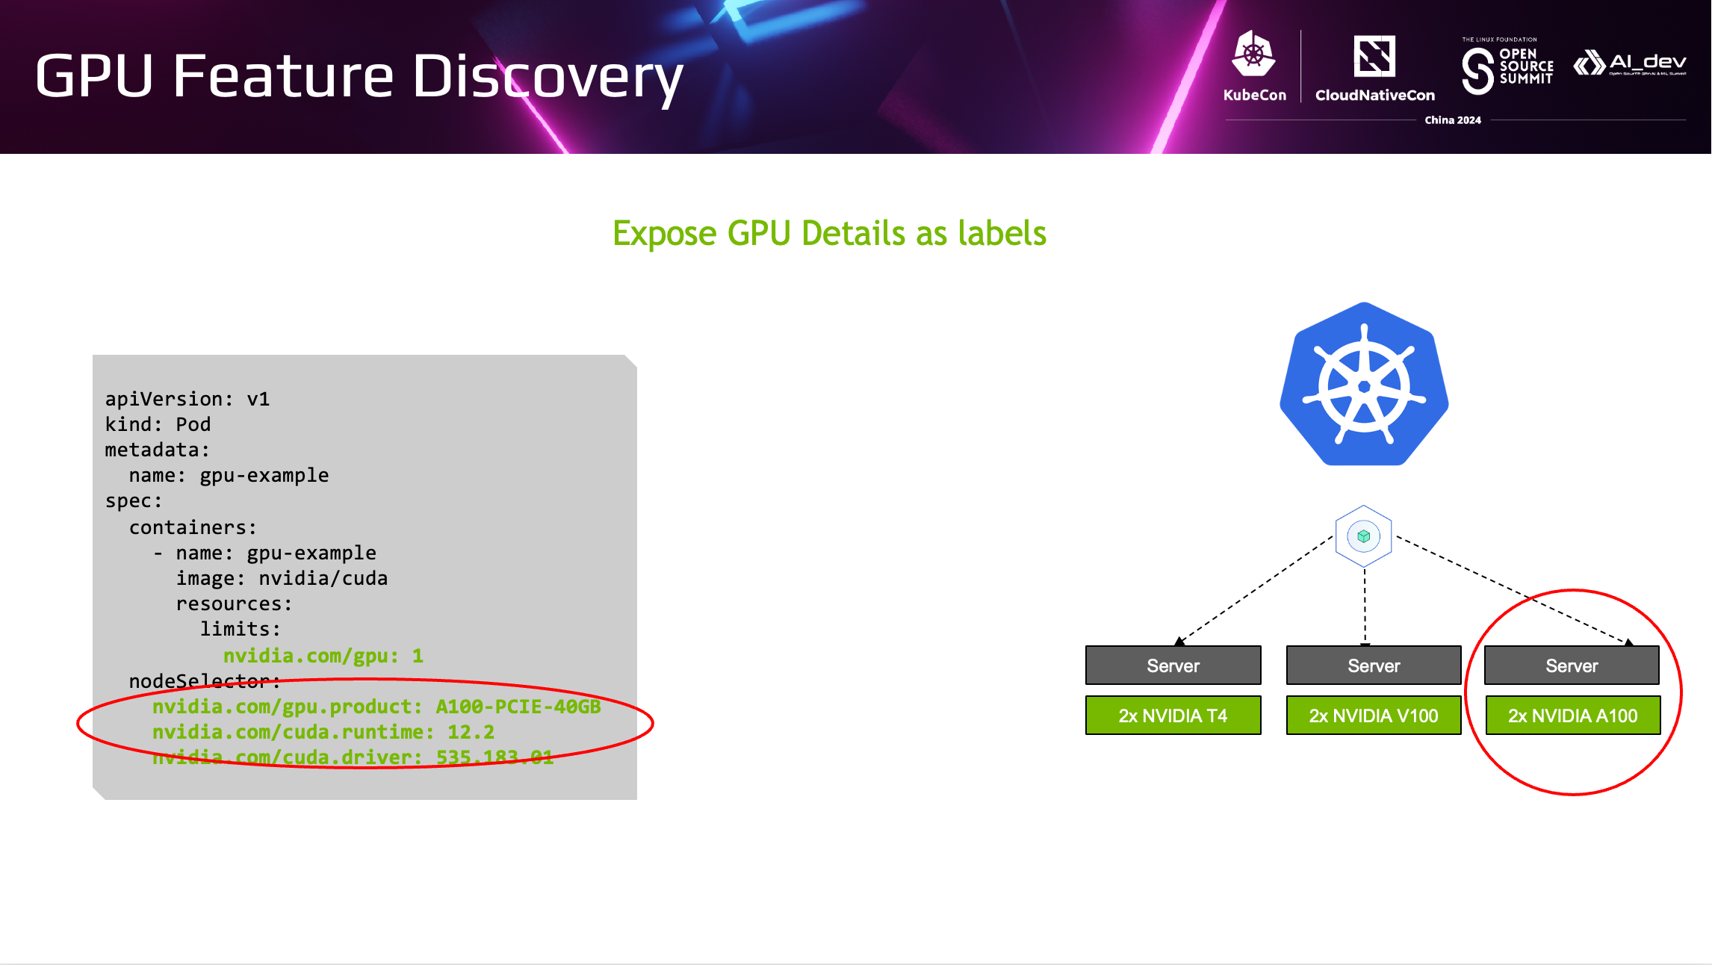

Slide 27
GPU Sharing & Scheduling

Slide 28
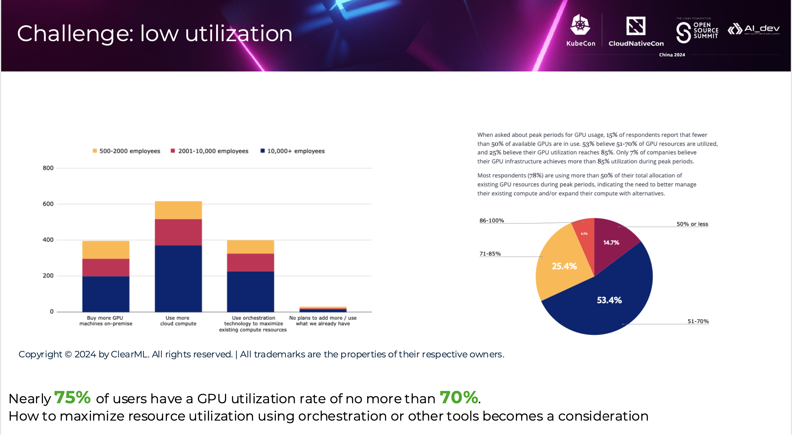

Slide 29
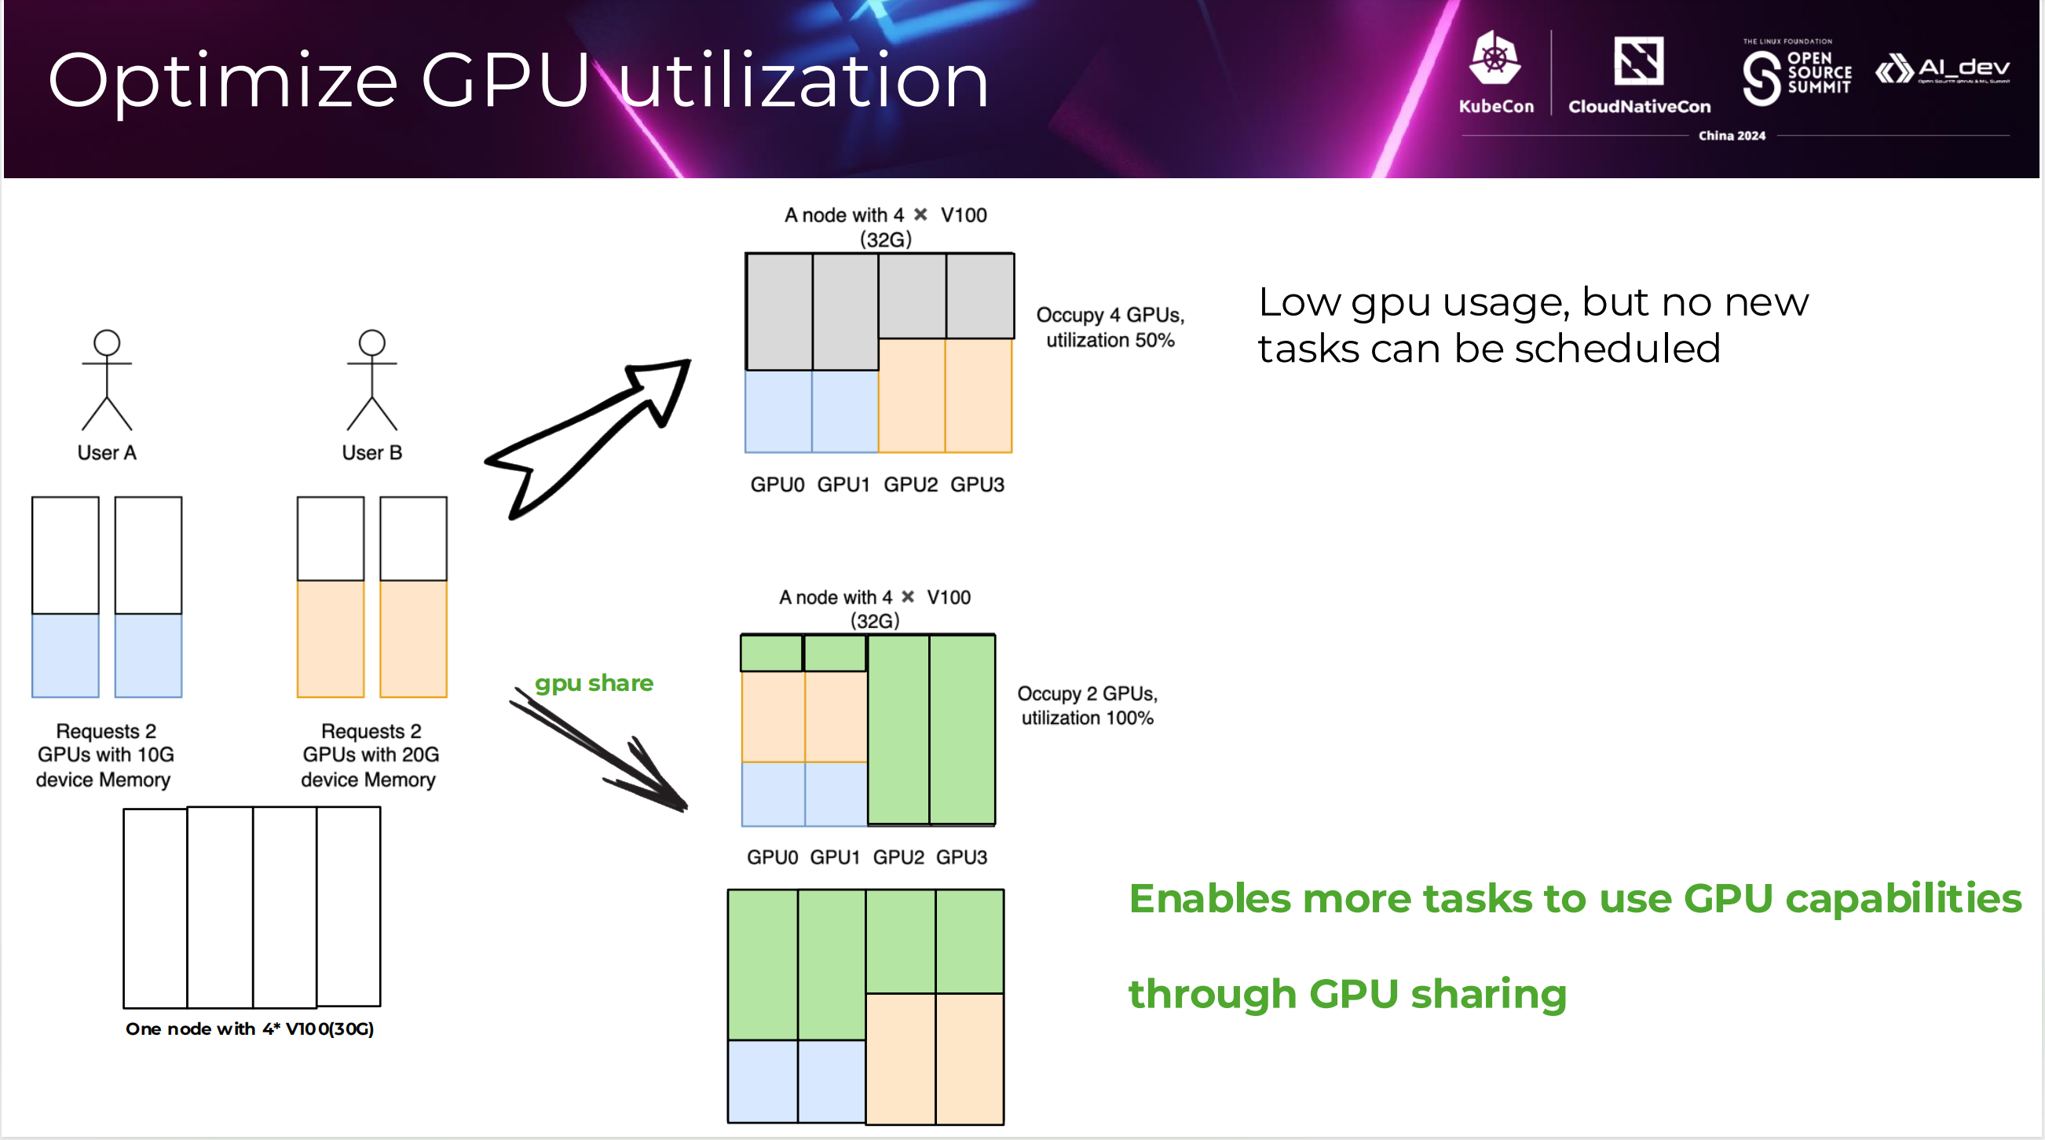

Slide 30
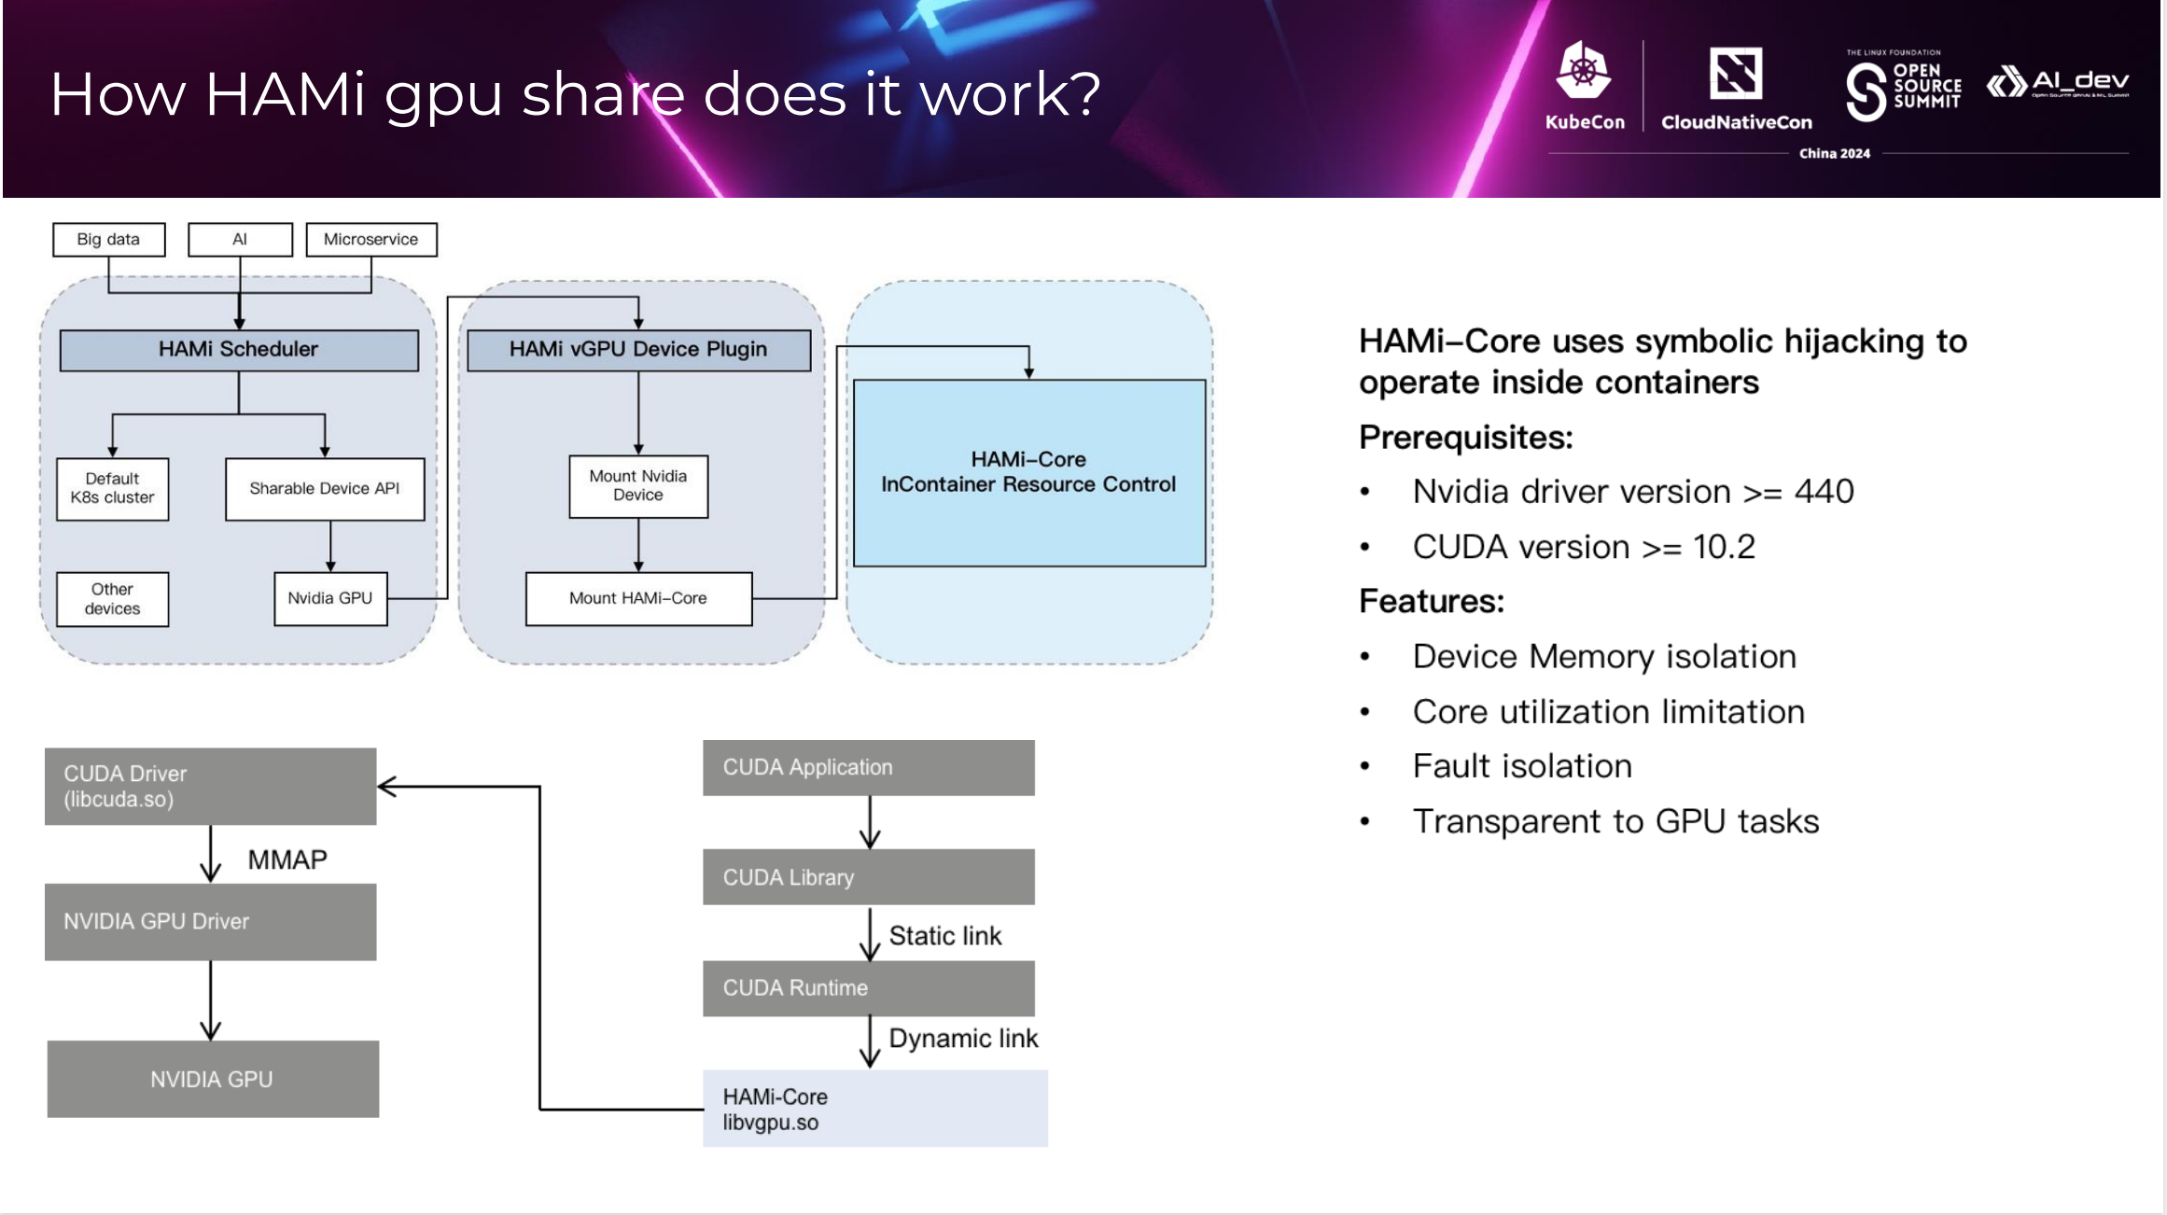

Slide 31
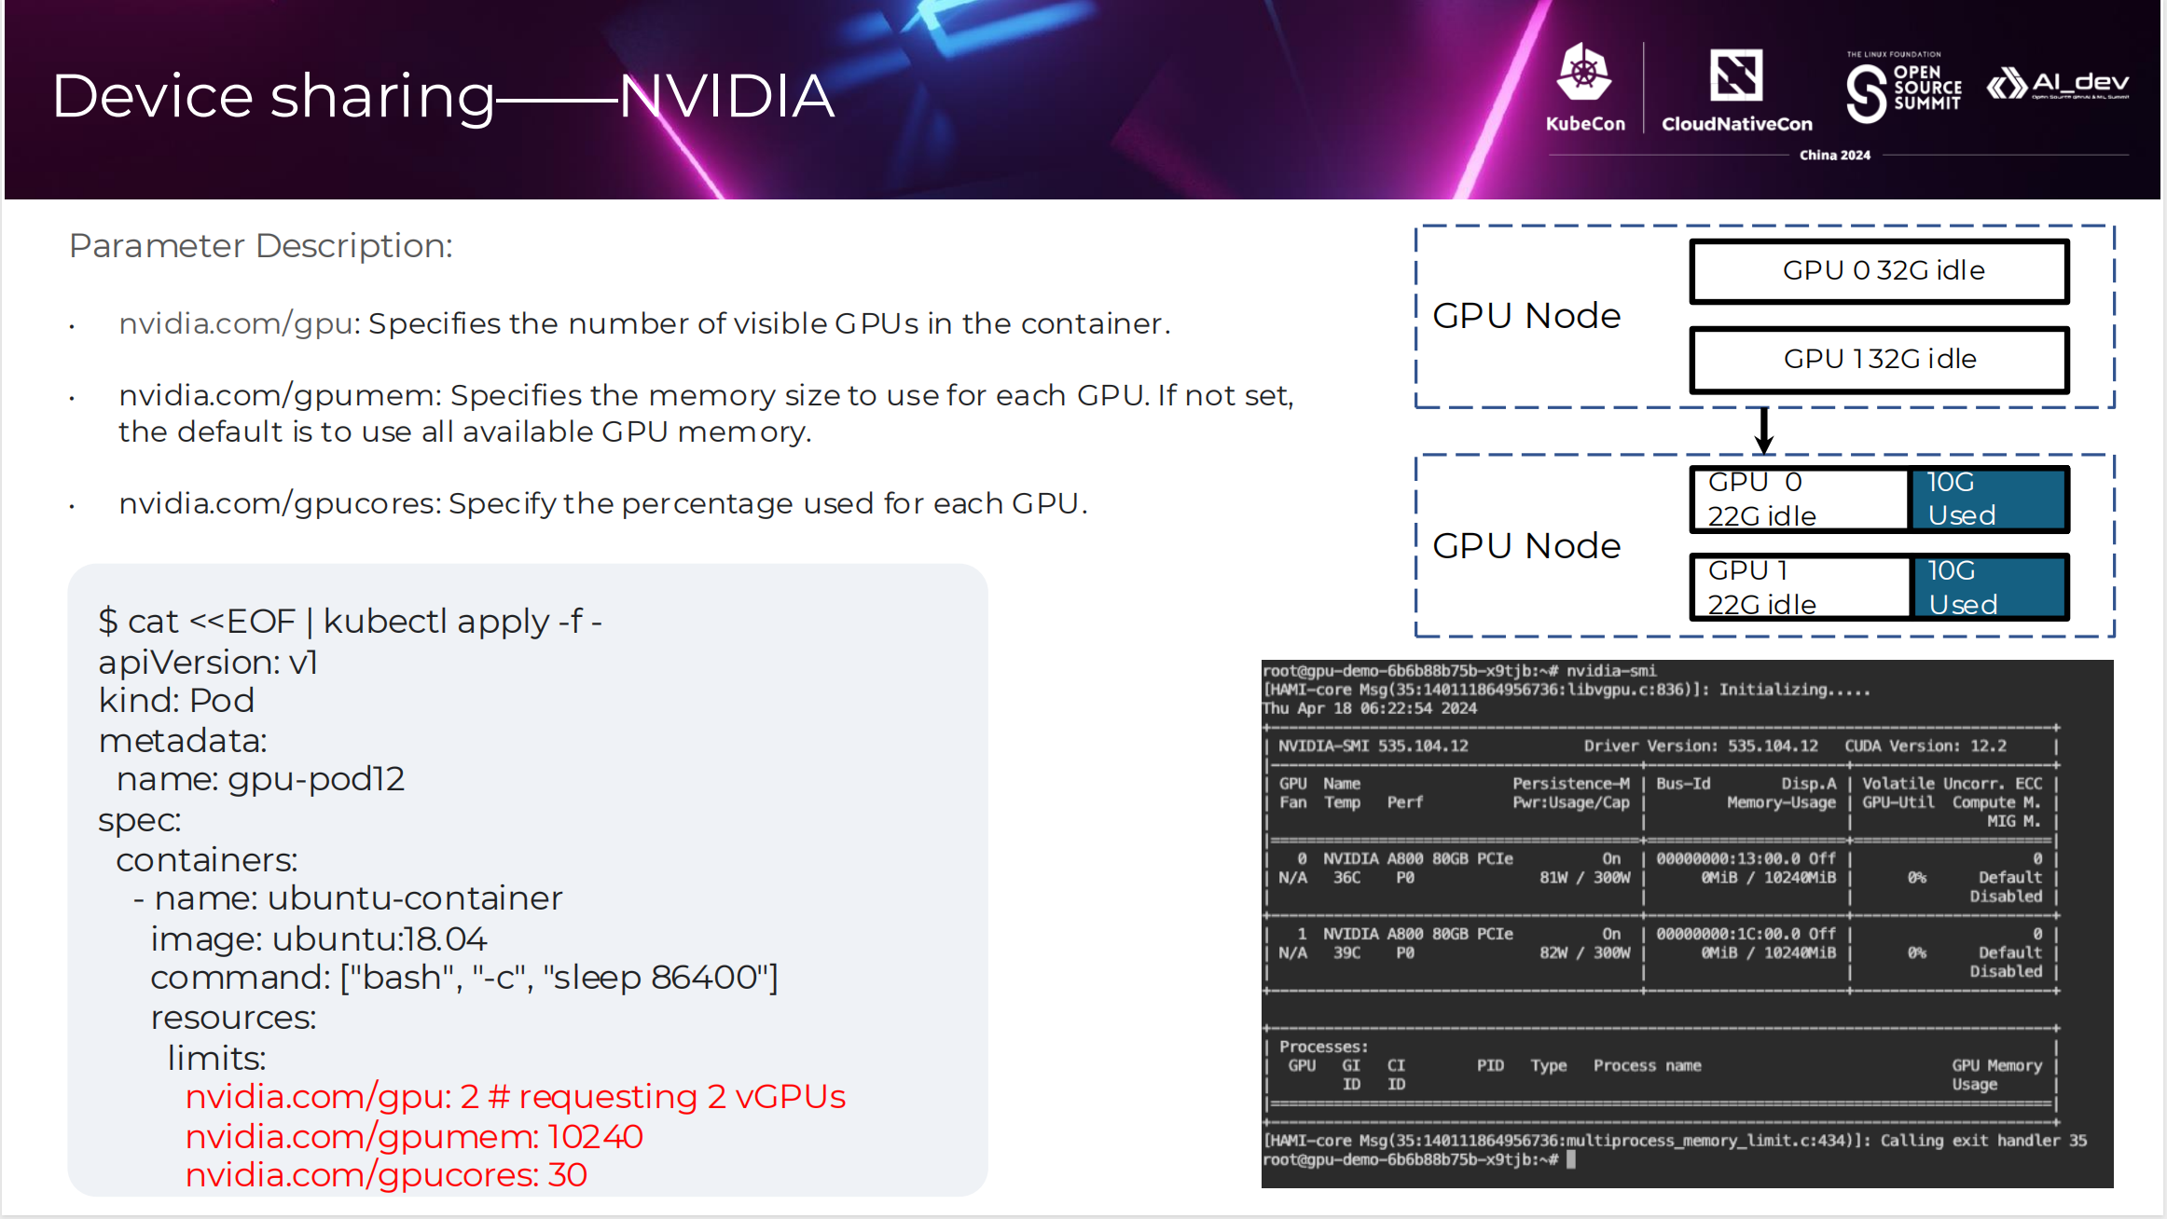

Slide 32
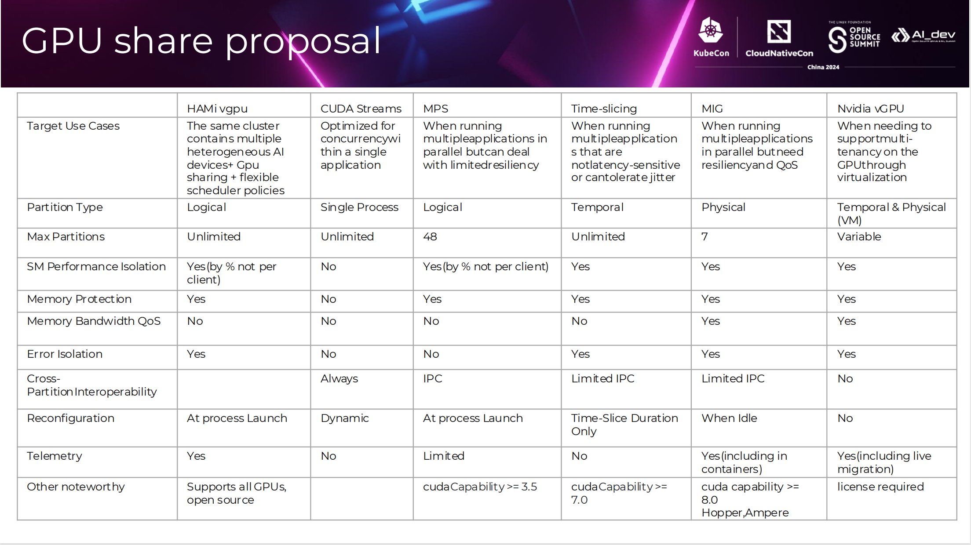

Slide 33
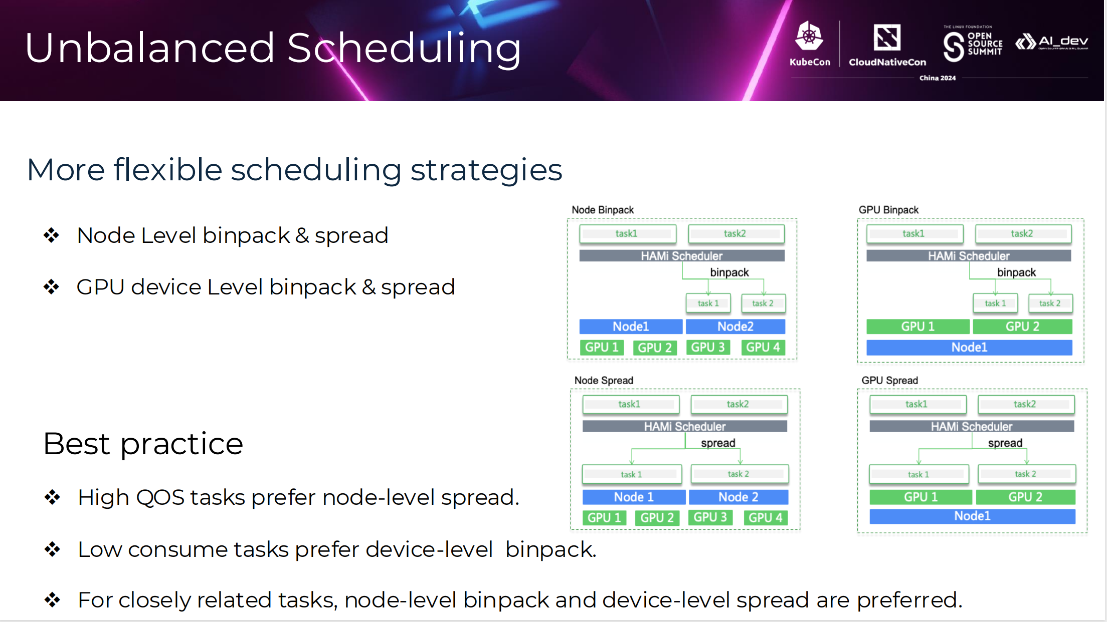

Slide 34
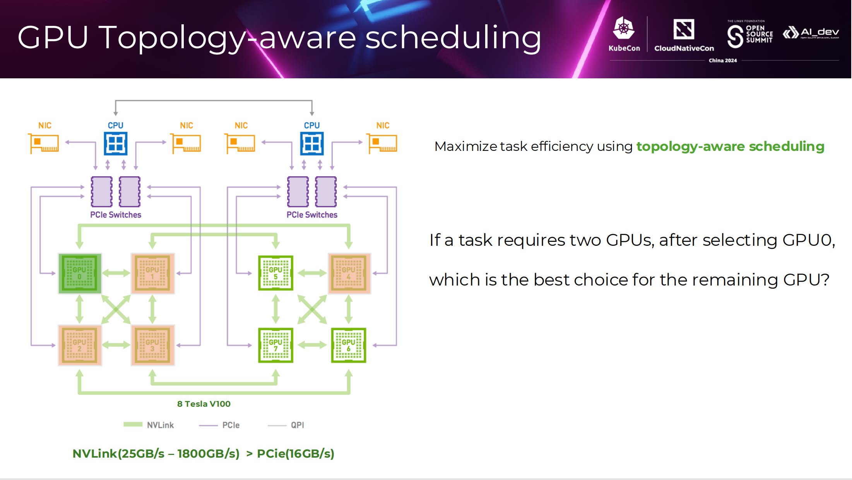

Slide 35
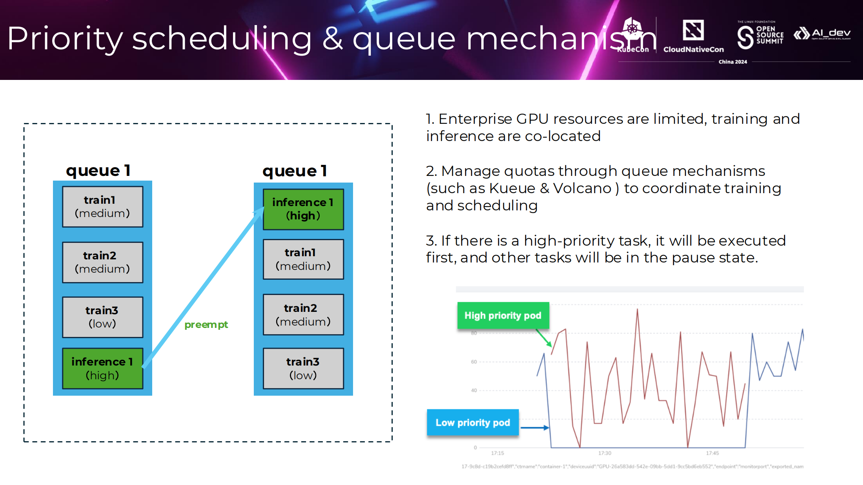

Slide 36
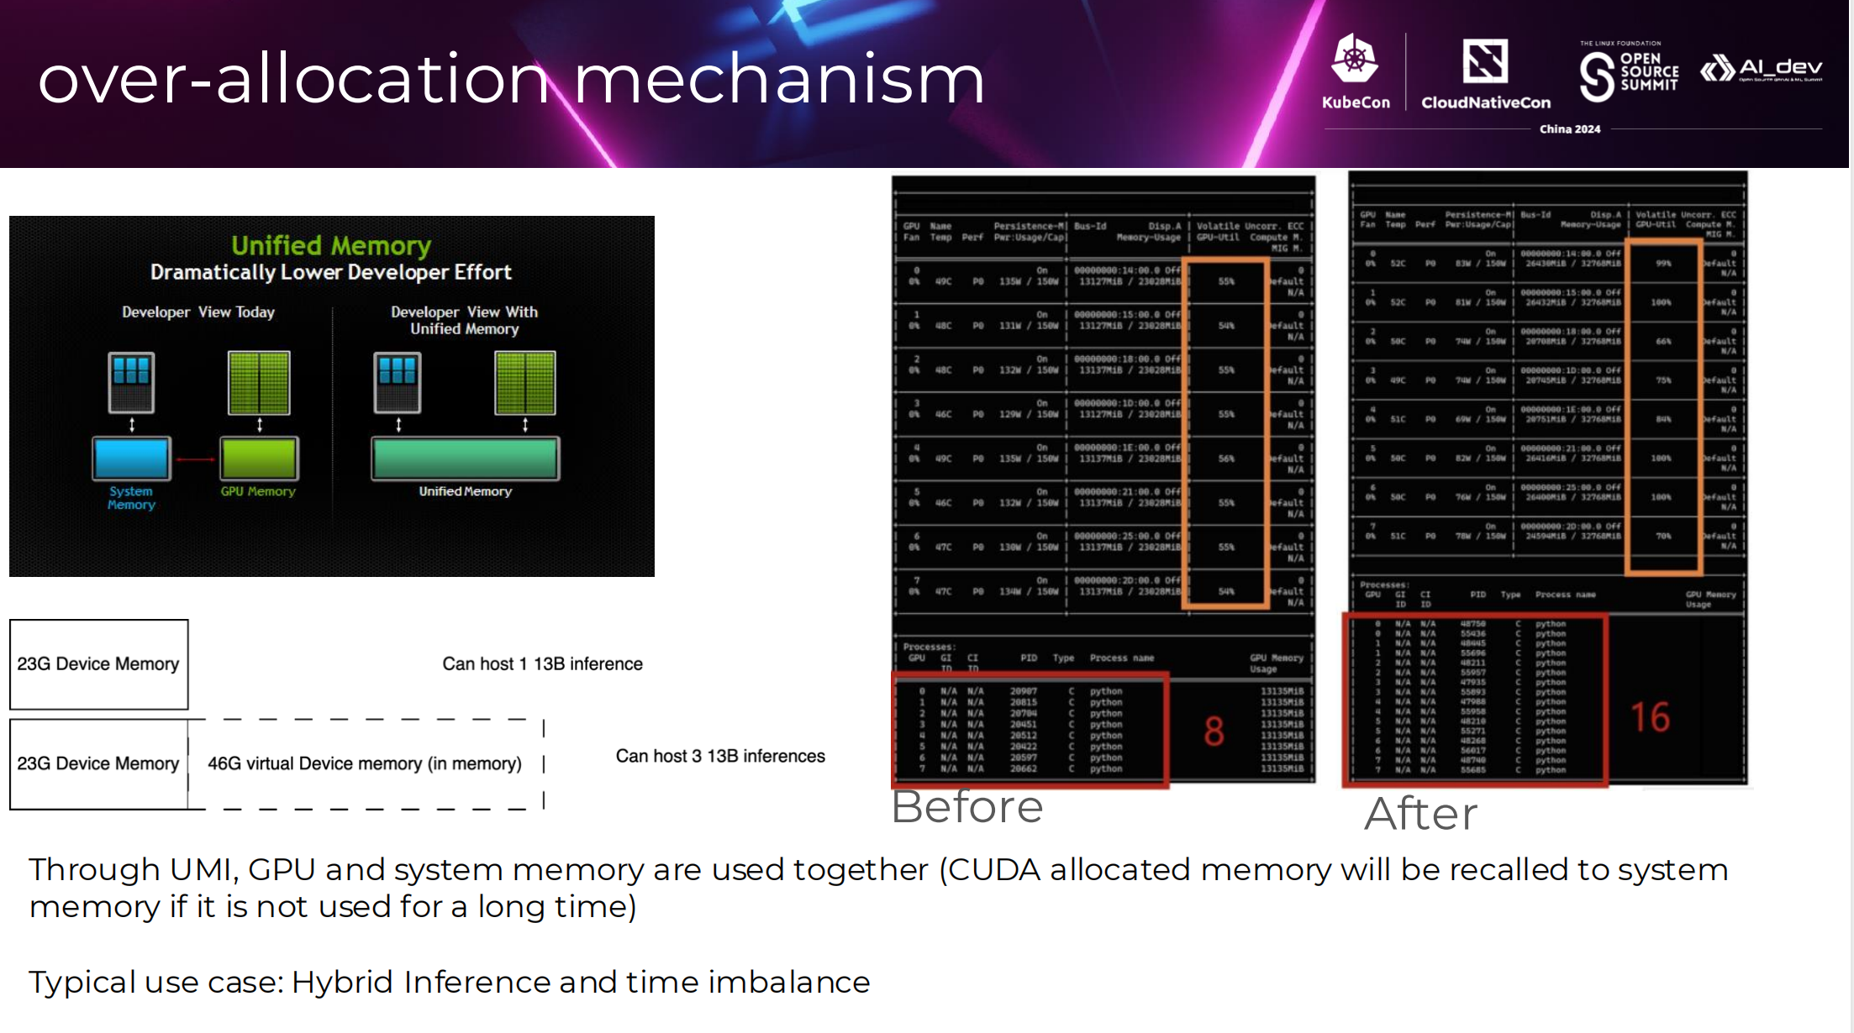

Slide 37
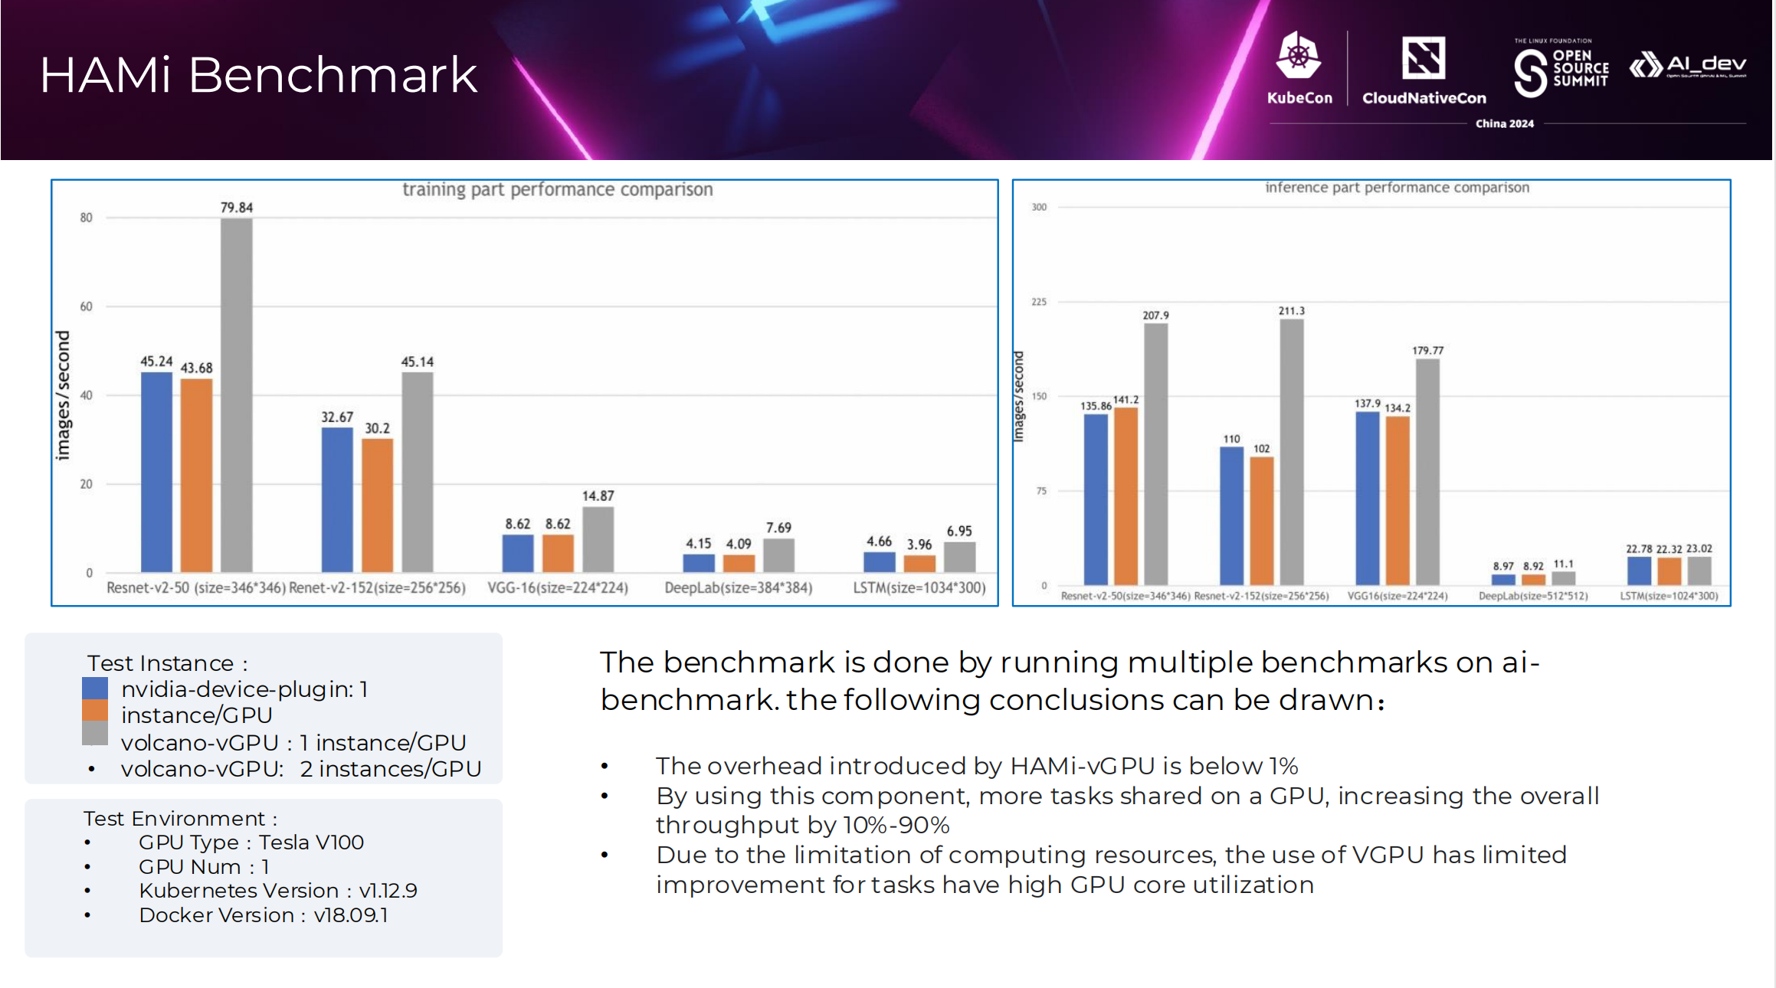

Slide 38
Failure Recovery and Fault-Tolerance

Slide 39
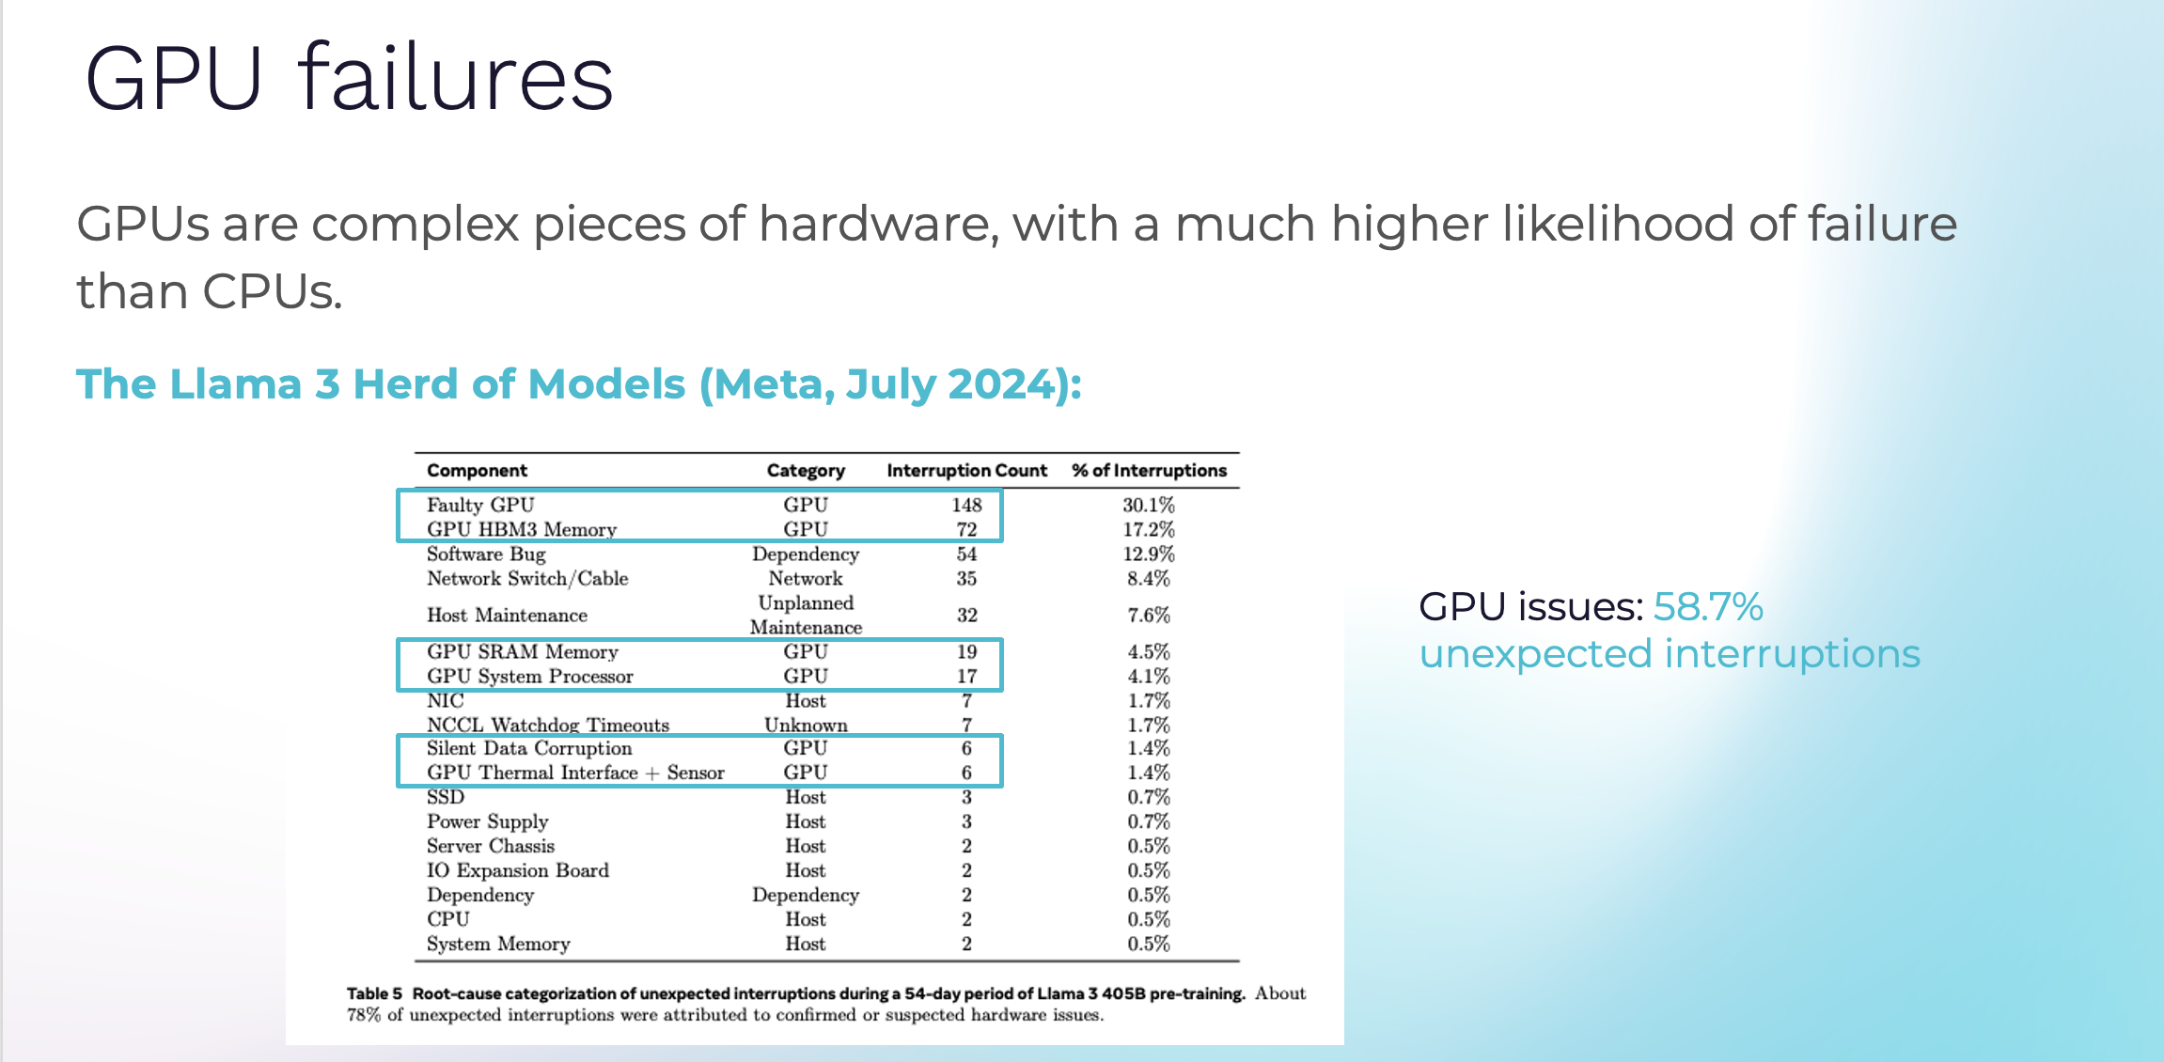

Slide 40
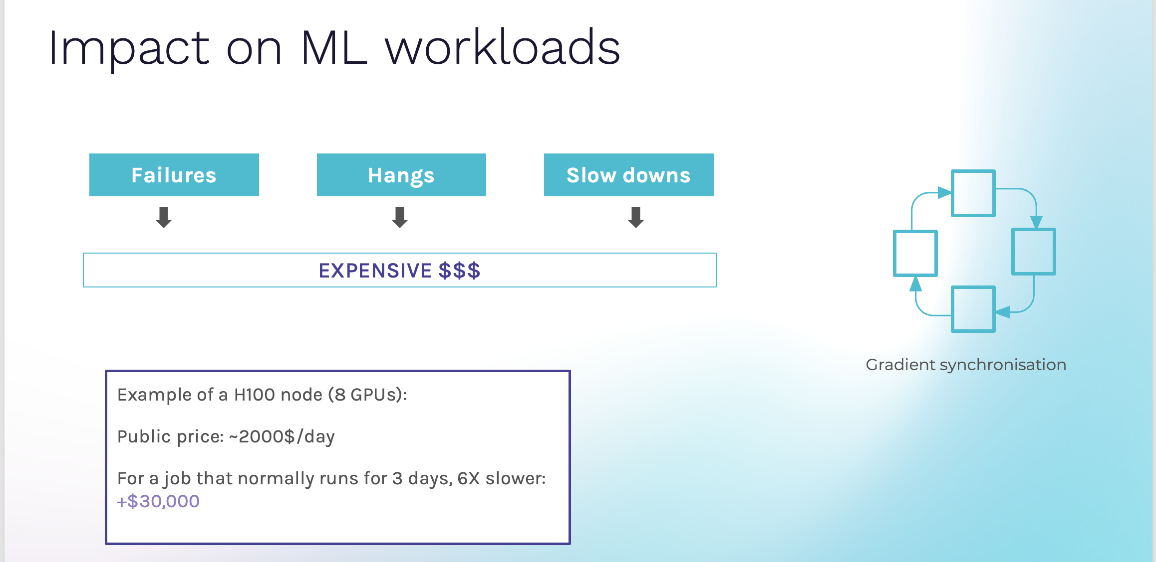

Slide 41
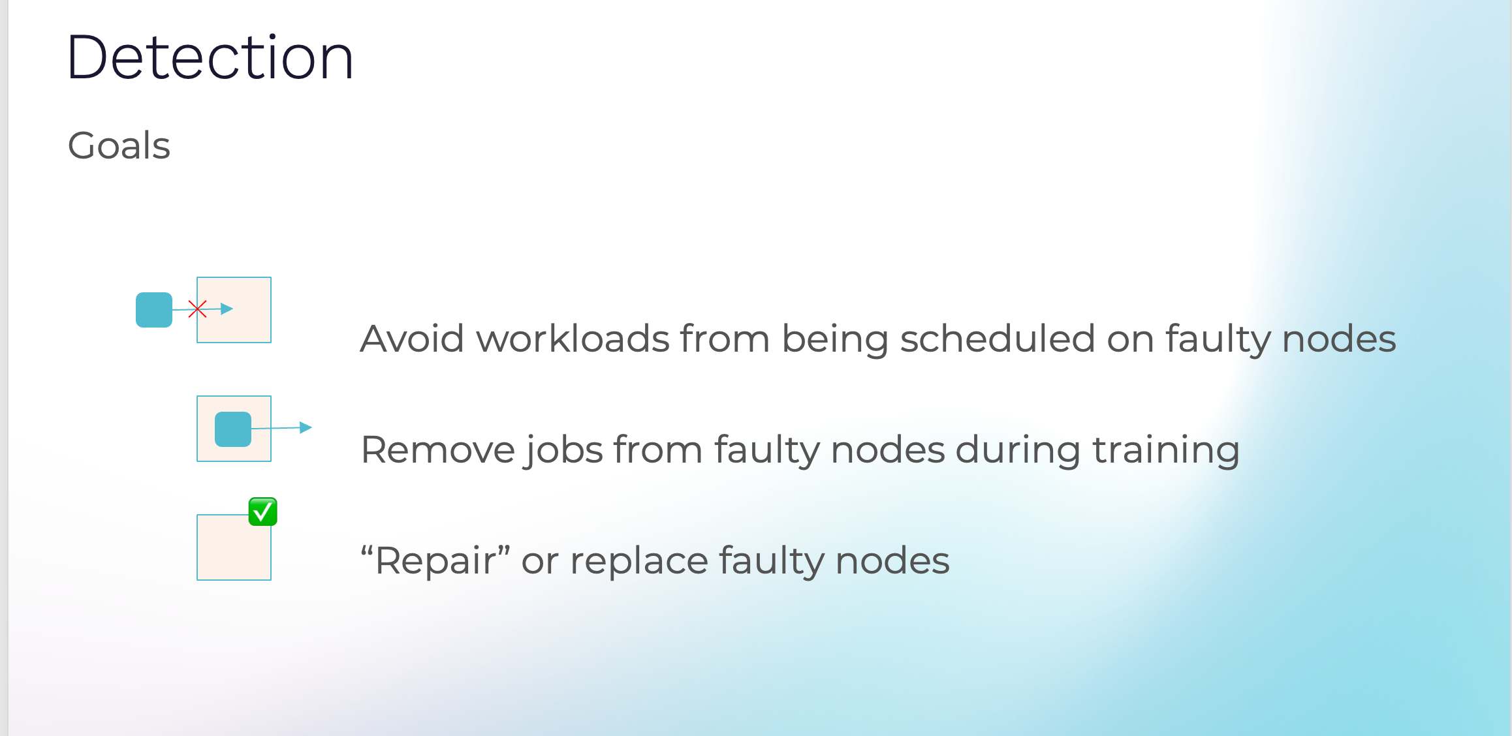

Slide 42
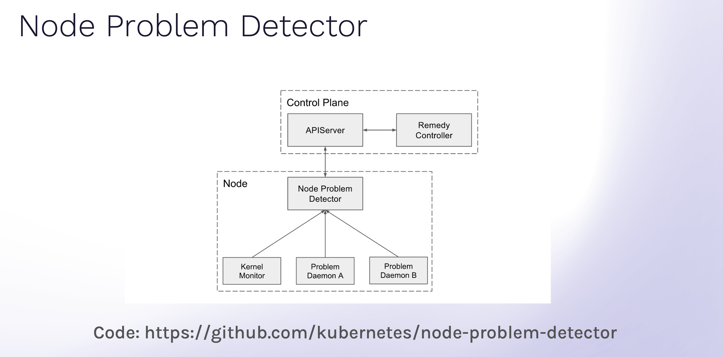

Slide 43
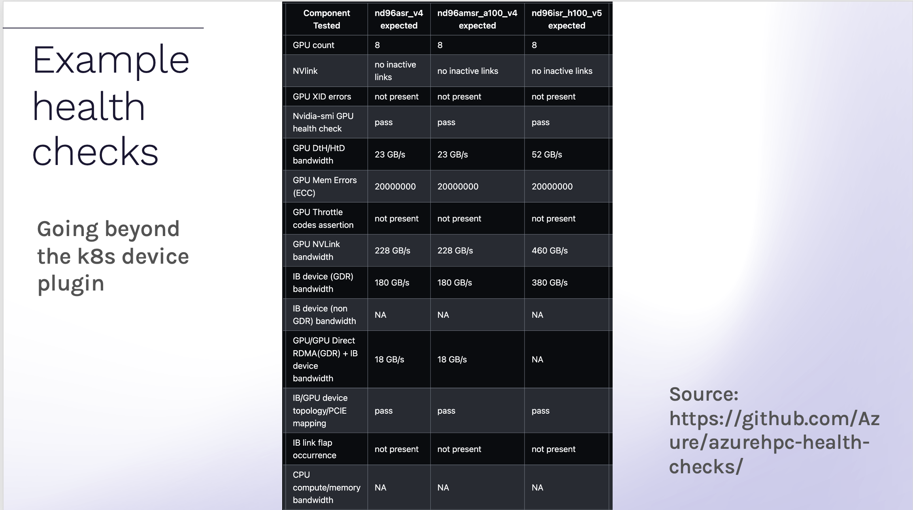

Slide 44
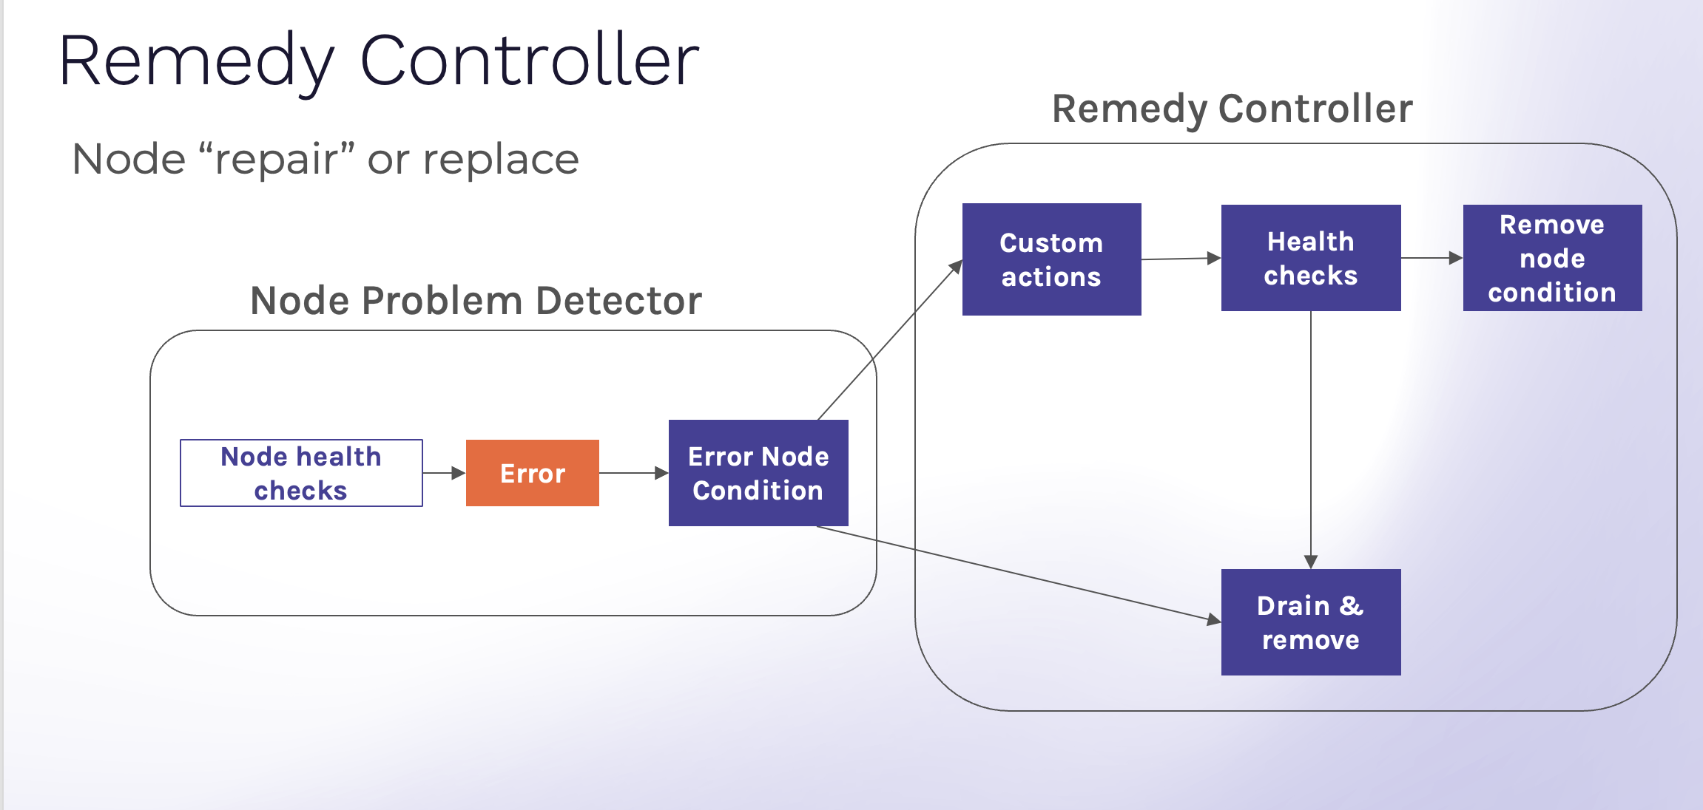

Slide 45
Demo
GPU node health checks integrated into Azure Kubernetes
service via node problem detector

Slide 46
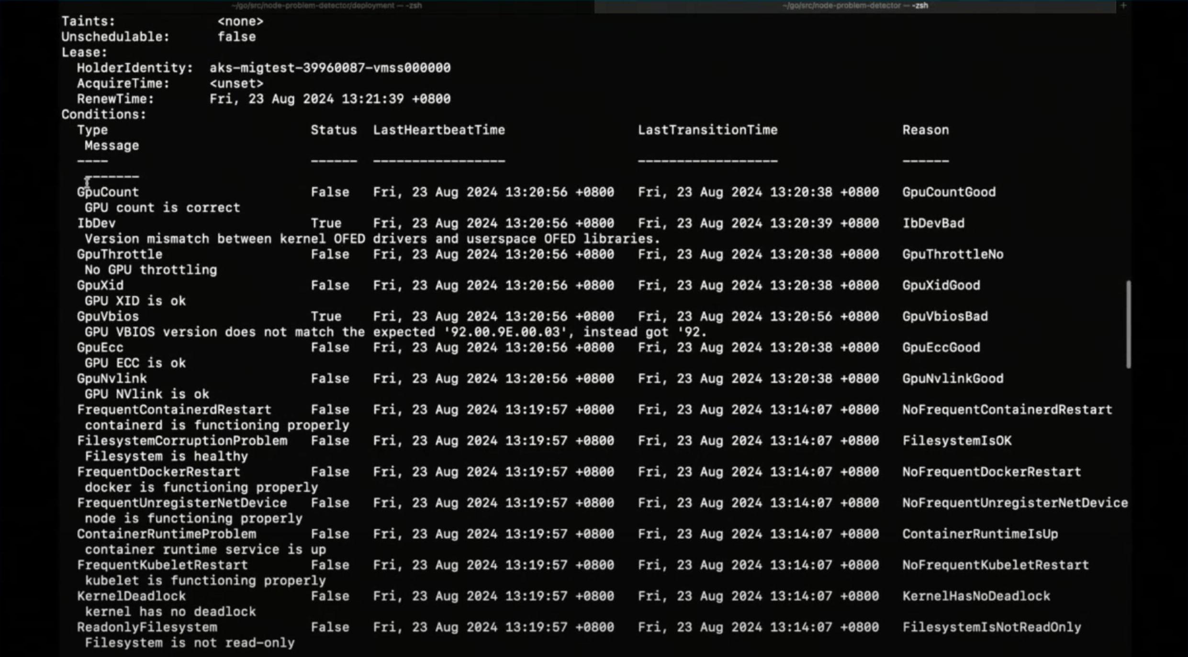
Custom Node Problem Detector

Slide 47
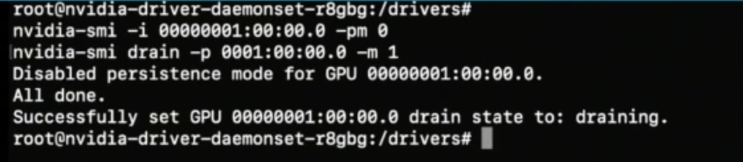
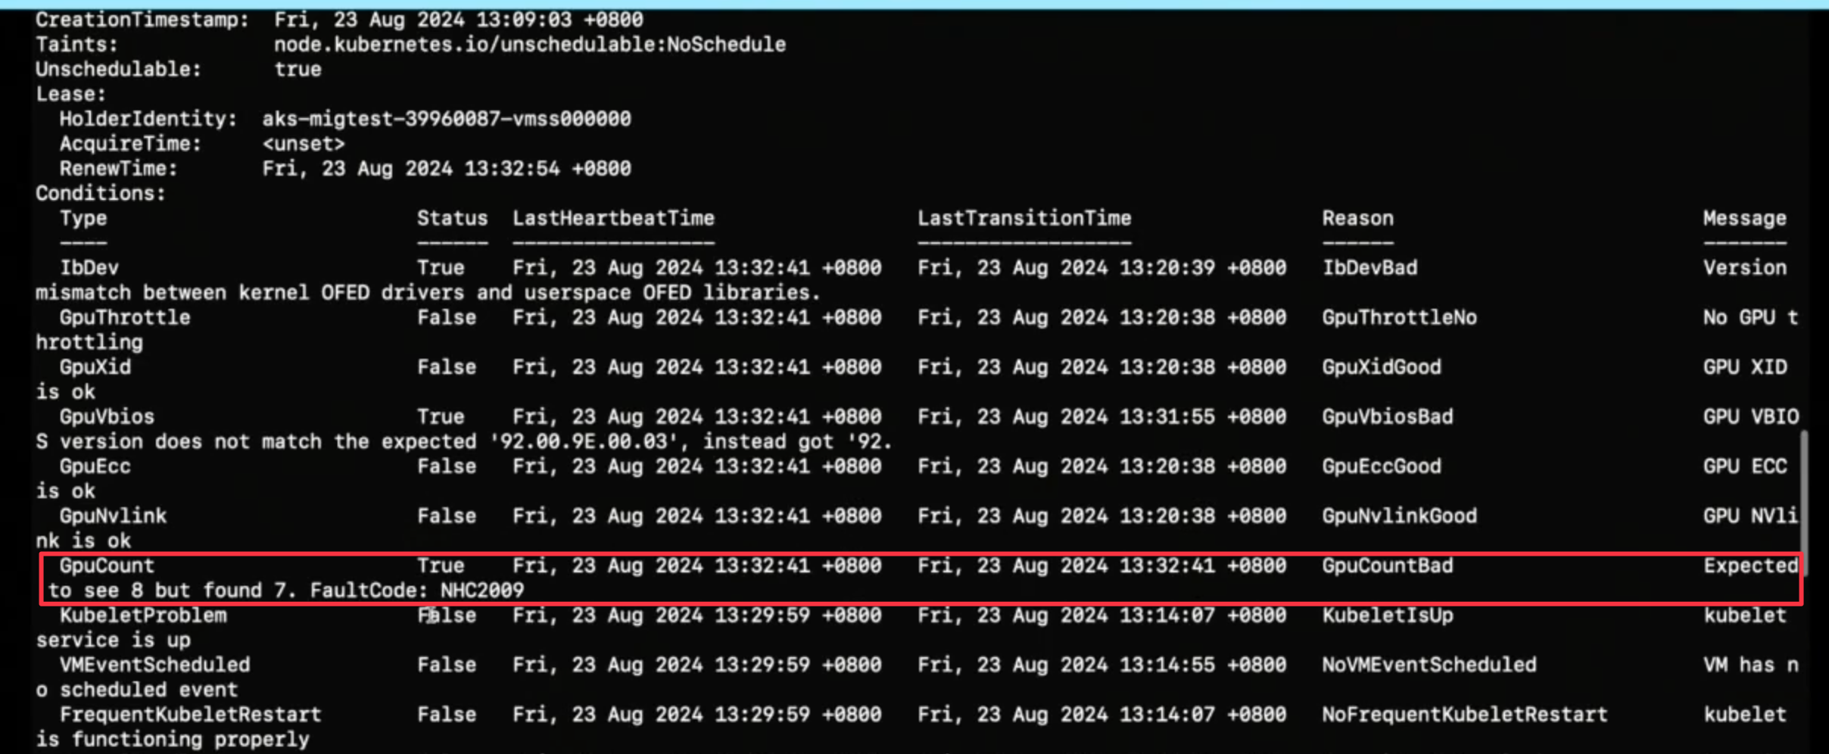
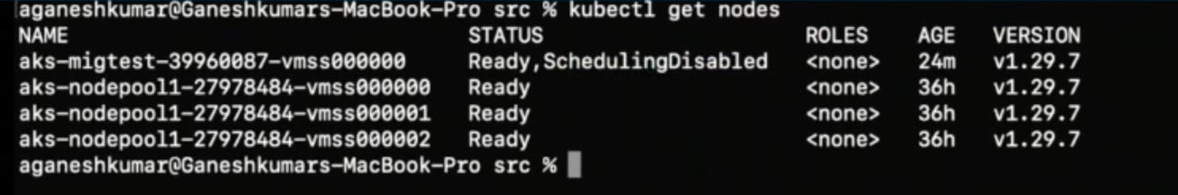
Drain unhealthy GPU node

Slide 48
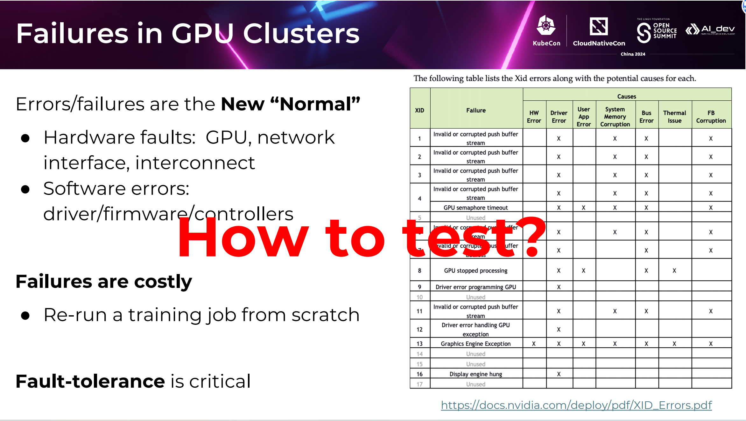

Slide 49
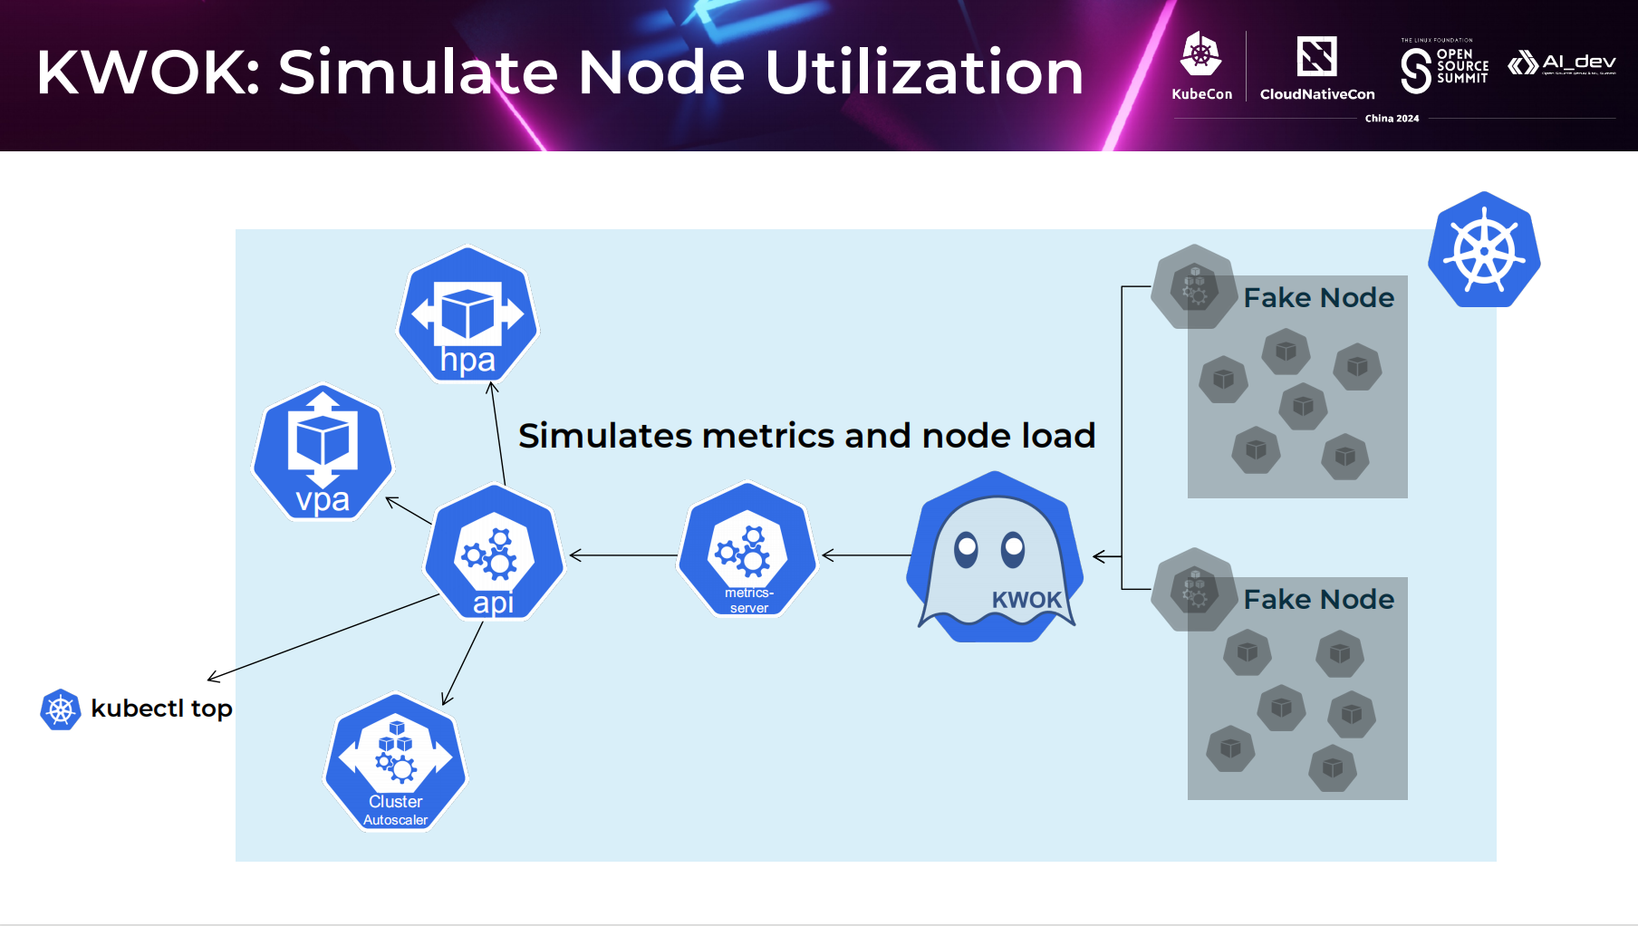

Slide 50
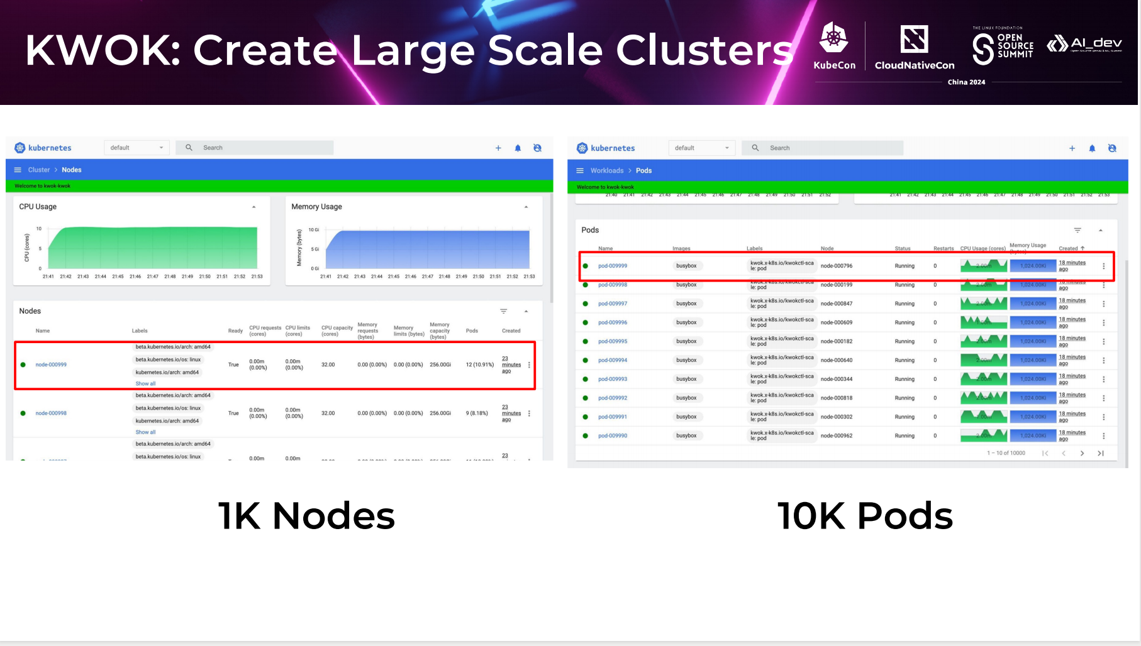

Slide 51
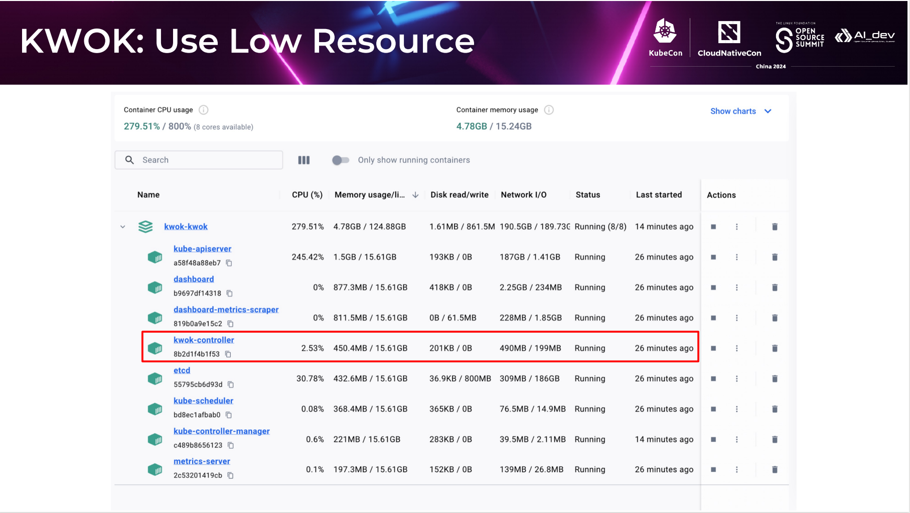

Slide 52
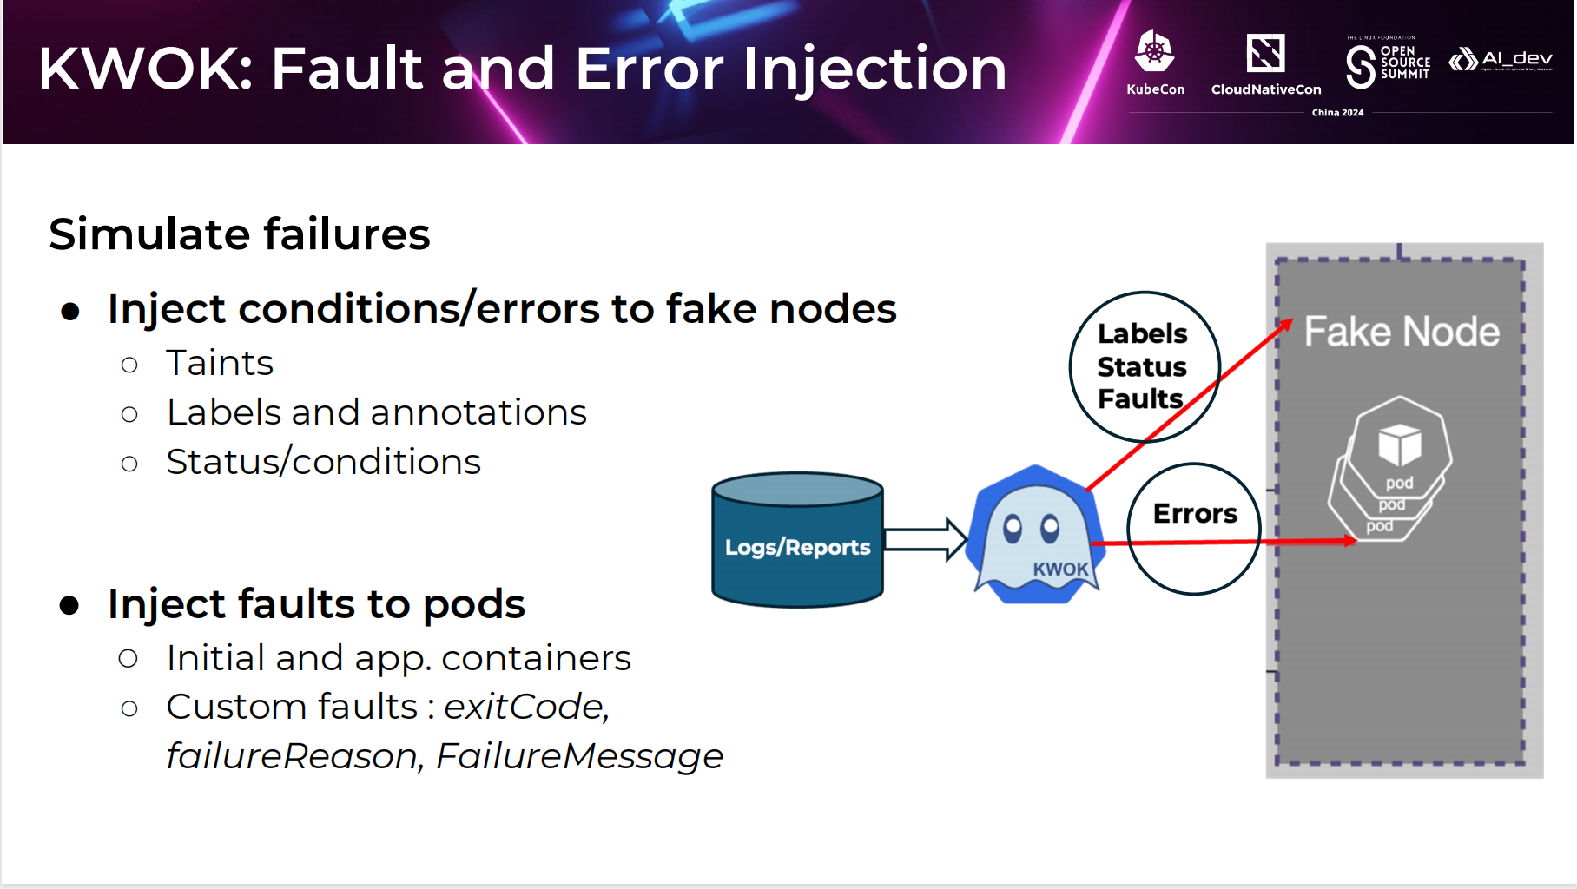

Slide 53
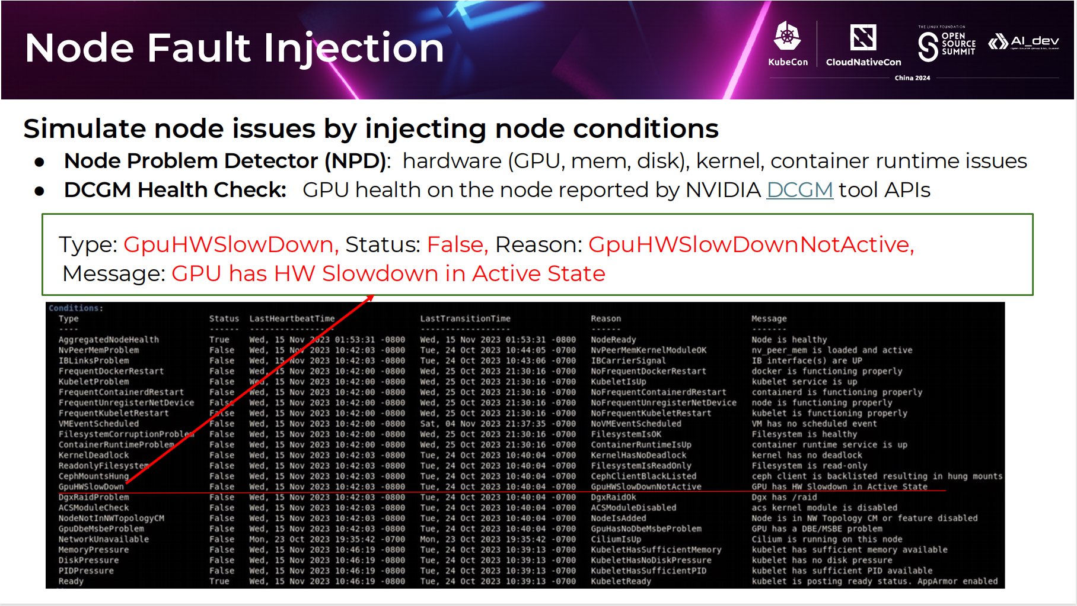

Slide 54
Thank You

